Slide 1
Panel Discussion: C4I Solutions for Combating
Cyber-Terrorism and Managing Crisis
Lieutenant Colonel Dr. Esa Alotaibi Director of Communications and Networks Security Department, Air Defence Forces, Ministry of Defence, KSA

Slide 2
outlines
Concept of C4I System
Today’s C4I Battle Fields
Battlefield Capacity Perspective
C4I Challenges & Threats
Addressing the Cyber Threats
Case Study
Top 10 Cyber Security Threat of Future
Managing Solutions for Combating Cyber for the Future
Cyber Security Market Trends

Slide 3
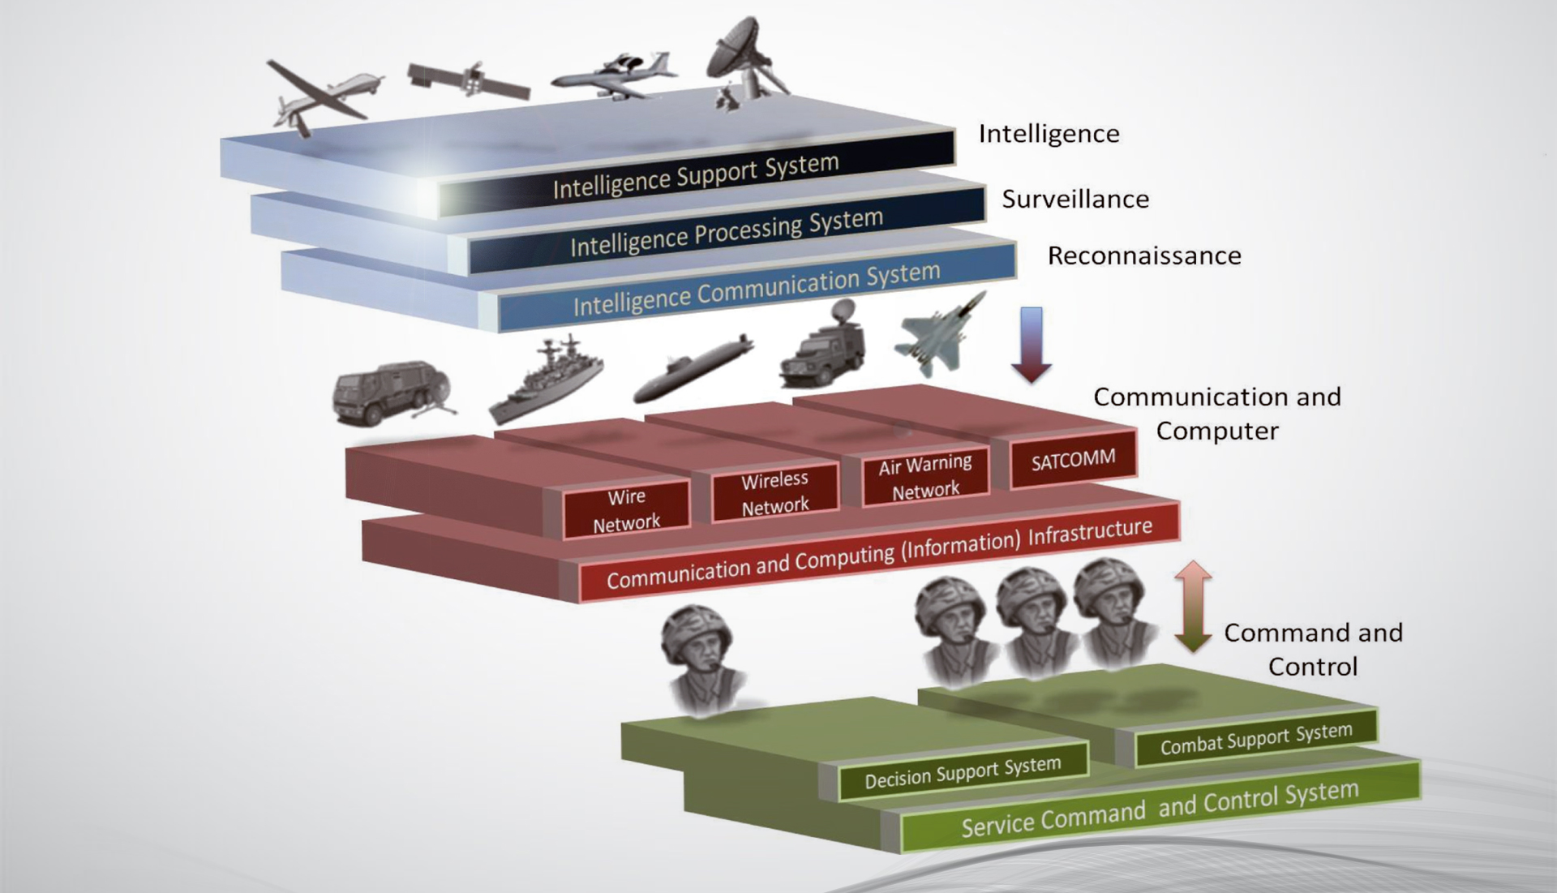
Concept of C4I System

Slide 4
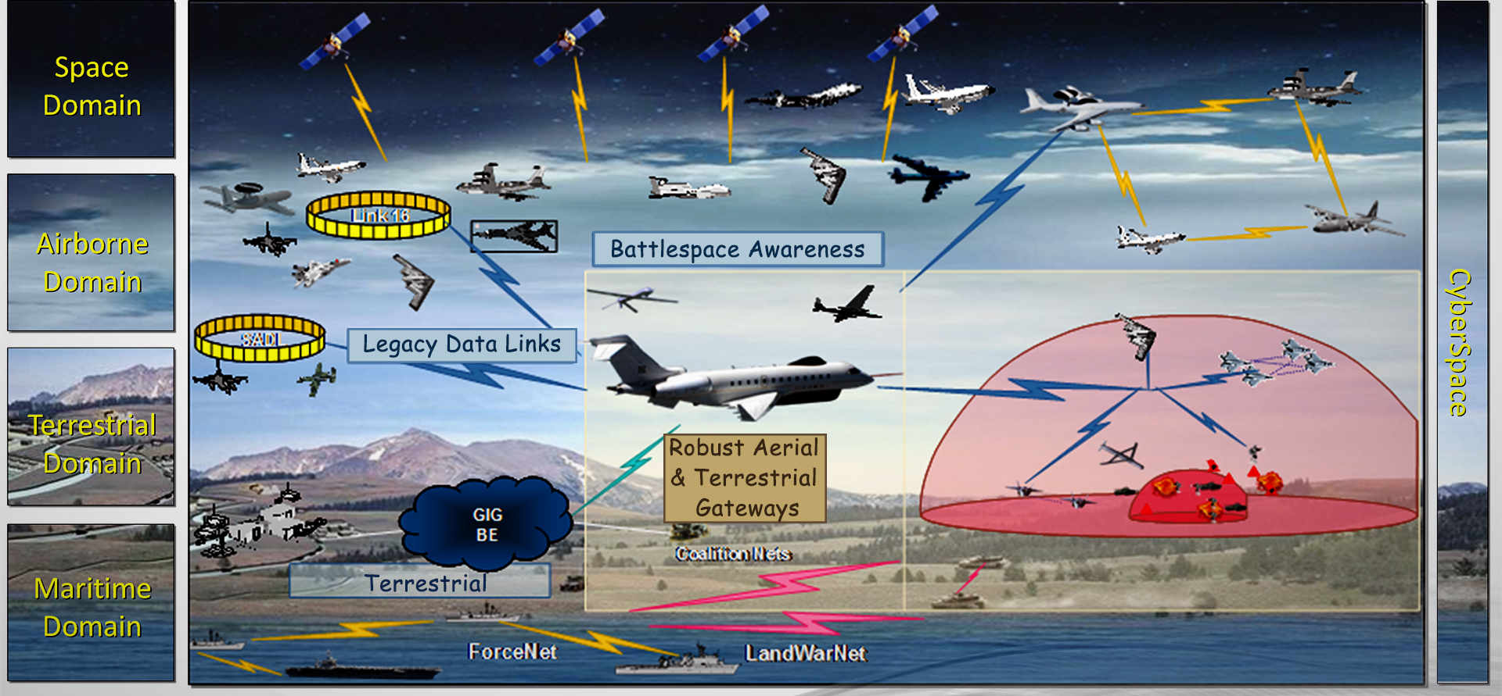
Today’s C4I Battle Fields
Space: Transformational Communications
Terrestrial: GIG / Enterprise Service
Airborne: Airborne Networking
Maritime: Network Centric Warfare

Slide 5
Battlefield Capacity Perspective
Group Services by Type (or mission)
Surveillance
Communications
Tactical
In operations of any nature its essential to ascertain impact of cyber attack by capability

Slide 6
C4I challenges and threats
Threat
Monitoring
Perspective
Computer virus will be introduced via radio channels and laser communication links
Jamming
Accomplishing Electronic Warfare by jamming enemy communications
Corrupting
Introduce computer viruses by agents, over communications channels, or other means
Saturate enemy information networks with false commands and reports, misleading him and corrupting his C2 system
Deception by imitating the operation of enemy communication and by changing radio traffic volumes
Penetrating classified and unclassified info networks and channels to transmit false info
Spoofing
Deceiving
Target
Destroying
Directed beam electromagnetic pulse will become a new means of warfare against C4I and intelligence systems by 2010-2020

Slide 7
Addressing the Cyber Threats
External:
Monitoring
Direction Finding
Jamming (EW)
Tactical Deception
Internal:
- Overrun Scenarios
- Denial Of Service
- Deception and False Reporting
- Data Exposure
Threat
Countered By:
LPI/LPD technologies
Encryption
Countered By:
Monitoring
Access Control
Mitigate
LPI/LPD : (Low Probability of Intercept/Low Probability of Detection)

Slide 8
Case Study: Cyber Security Threats
during Olympic Game 2012

Slide 9
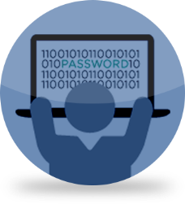
Top 10 Cyber Security Threats of Future
Phishing attacks
negligent insider
apt attacks
cyber attacks
zero day attacks
Malicious insider
social engineering
DoS attacks
brute force attacks

Slide 10
Managing Solutions for Combating of Cyber for the Future
Attacker Reconnaissance
Scan
Monitor
= Attacker events
Target
Analysis
Spoof
= Defender events
Fortification
Jam
Access
Probe
System
Intrusion
Cover-Up
Direction
Find
Damage
Inflicted
Orientate
Or Map
Attack
Mounted
Capture
Damage
Inflicted
Traffic
Jam
Time
Recovery
Physical Security
Entry
Control
Intrusion Detection
Response
System Reaction
Threat Analysis
Attack
Forecast
Impact Analysis
Defender Reconnaissance
Damage Assessment
Education / Awareness / R&D / Testing / Deployment

Slide 11
Cyber Security Market Trends
Cloud Security
End Point Security
Insider Threat Management
Internet of Things IoT
Managed Services

