Slide 1
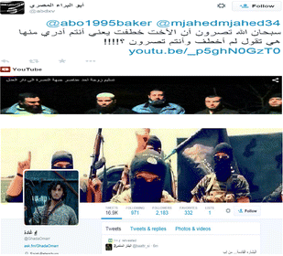
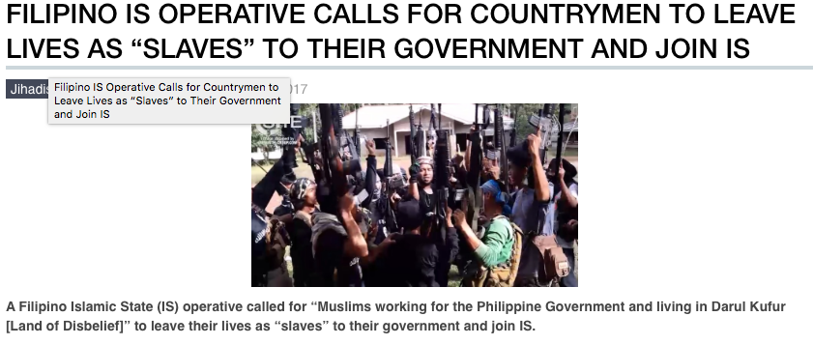
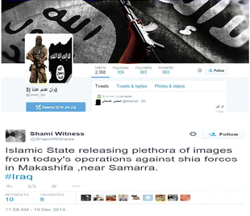
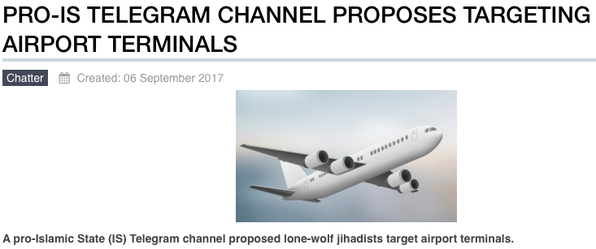
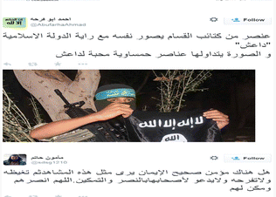
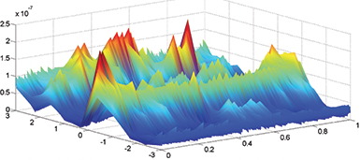
Social Media and CyberTerrorism 2nd International C4I & Cyber Conference, Riyadh Alliance Against Terrorism …. Capabilities and Strategies Mike Small

Slide 2
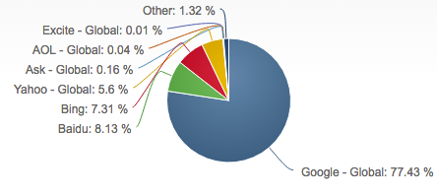
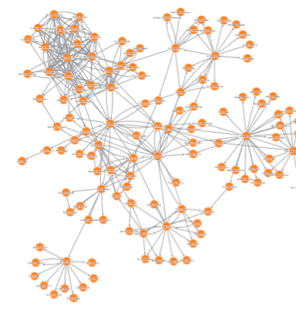
The Global Internet
Around 7.5 billion people in the world today
Around 3.8 billion internet users
There are 2.79 billion active social media users in the world.
an increase of 21 percent from 2016
Facebook now has over 2.01 billion monthly active users
Twitter has 328 million monthly active users (ie sending)
Around 500 million Tweets per day
Over 85 million photos and videos are shared on Instagram daily
1.17 Billion People Use Google Search
Google enjoys ~ 77% share of web search volume worldwide
Baidu has a 8.2% share / Yahoo 2.5% / Yandex 2.8% / Microsoft sites (mostly Bing) 7.3%
http://www.internetworldstats.com/stats.htm
https://hostingfacts.com/internet-facts-stats

Slide 3
Social Media in the Cyber-Battle-Space
Pew research: the use of social media in respect to harassment, extremism and cyber terrorism:
power of social media, is that we are now producers – not simply the audience
Environment of “Total Noise” spreads confusion and mistrust
Users are emotionally Disinhibited leading to ever increasing harassment
… which leads to an extremely Partasian climate that has intensified and invaded personal interactions
In the case of harassment users are emotionally Disinhibited from their activities
The “Attention Economy” creates demand, and incentivizes outrage and extremism
BOTS can play the game to … a force multiplier
It is becoming clear that many don’t want to engage
In other words, far from being a global debating forumn, it has become a grandstand for the few.

Slide 4
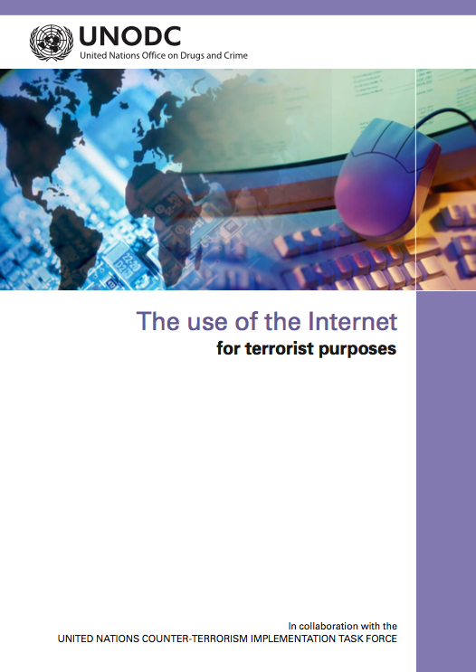
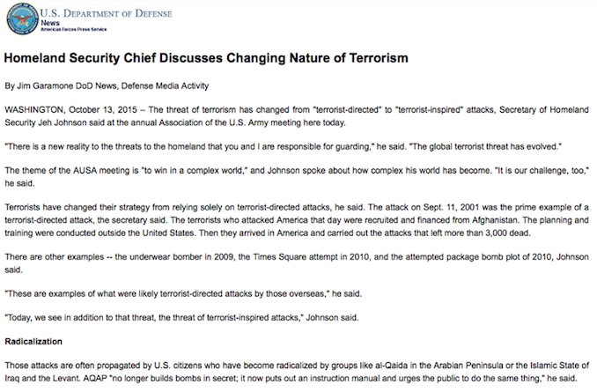
The Role of Social Media in Terrorism
Many reputable reports & texts on the subject:
2015 – Terrorism has changed from “Terrorist-Directed” to “Terrorist Inspired”
“Terrorist no longer build bombs in secret, they put the manual on Social Media”
Combatting Terrorism requires a whole of Government response”
Stopping homegrown terror means countering the extremist message
“The use of the Internet to further terrorist purposes disregards national borders” …. to promote a better understanding of the ways in which communications technologies may be misused in furtherance of acts of terrorism and to respond effectively, needs transnational response.

Slide 5
From Information Superiority to Cyber Superiority ?
Information Superiority:
Collect more information
Processes it for actionable Intelligence
Deliver it to the right commander in the right form
Underpins Intelligence Led Operations
and provides the premise that we can defeat the adversary more effectively, because we understand the battlespace better than he does.
The Big Issue: Can we ever achieve this is Cyber-Battle -Space ?
Intelligence
Requirements
Commanders
Actionable Intelligence
Dissemination
Management
Collection
Management
Disseminate
Direct
Information
Management
Collection
Coordination
Exploitation
Management
Process
Collect

Slide 6
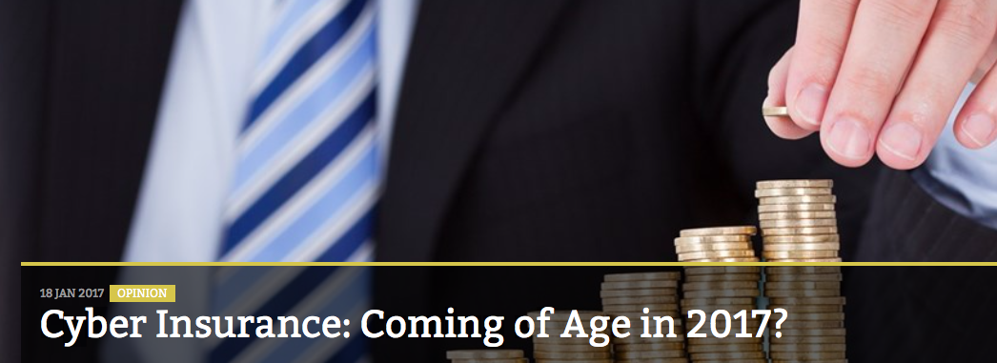
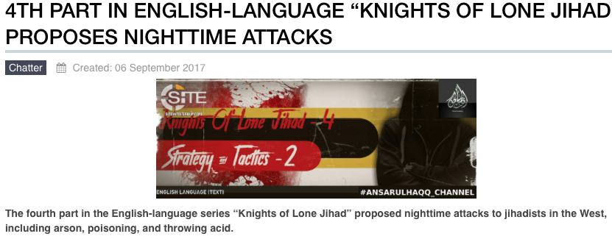
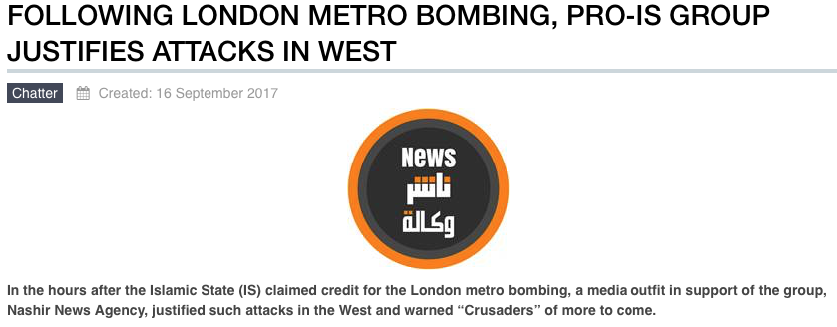
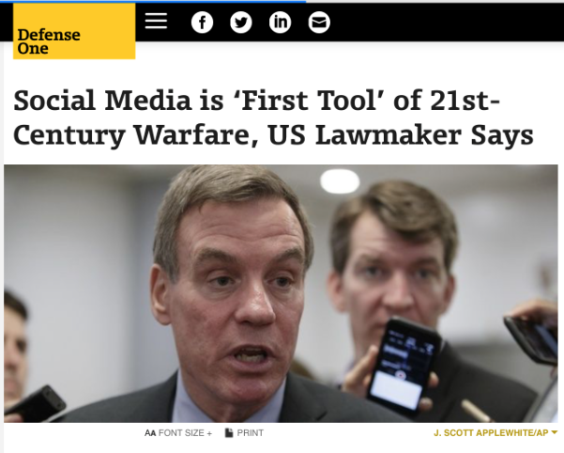
Cyber Superiority: So who is winning the Cyber-Battle-Space ?
In 2016 "cybercrime cost the global economy over $450 billion,
over 2 billion personal records were stolen and in the U.S. alone
over 100 million had their medical records stolen,”
“And buying Facebook advertisements is much cheaper than an F-35 jet”
US Senator Mark Warner
https://ent.siteintelgroup.com
For Enterprises: At the criminal Level
For Society: At the Cyber-Terrorist Level
For Nations: the geo-political level

Slide 7
Defence in Cyber-Battle-Space in the Social Media Age
In 2016 "cybercrime cost the global economy over $450 billion,
over 2 billion personal records were stolen and in the U.S. alone
over 100 million had their medical records stolen,”
“And buying Facebook advertisements is much cheaper than an F-35 jet”
US Senator Mark Warner
https://ent.siteintelgroup.com
For Enterprises: At the criminal Level
For Society: At the Cyber-Terrorist Level
For Nations: the geo-political level
More Emphasis on Defending our Information Infrastructure
Understand Social Media &
Counter-Speech

Slide 8
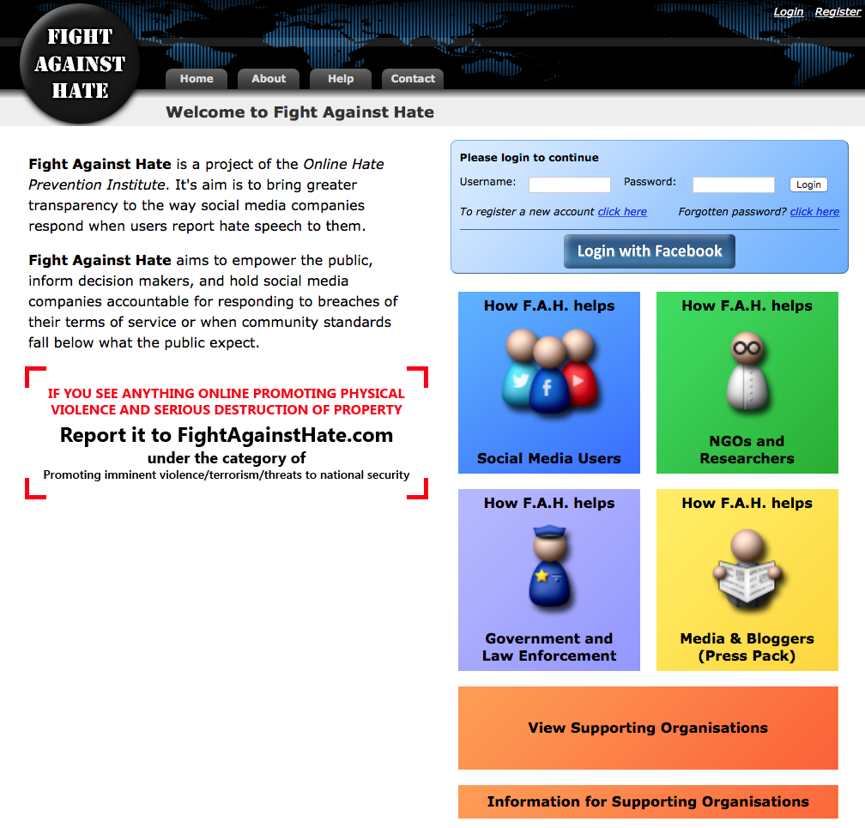
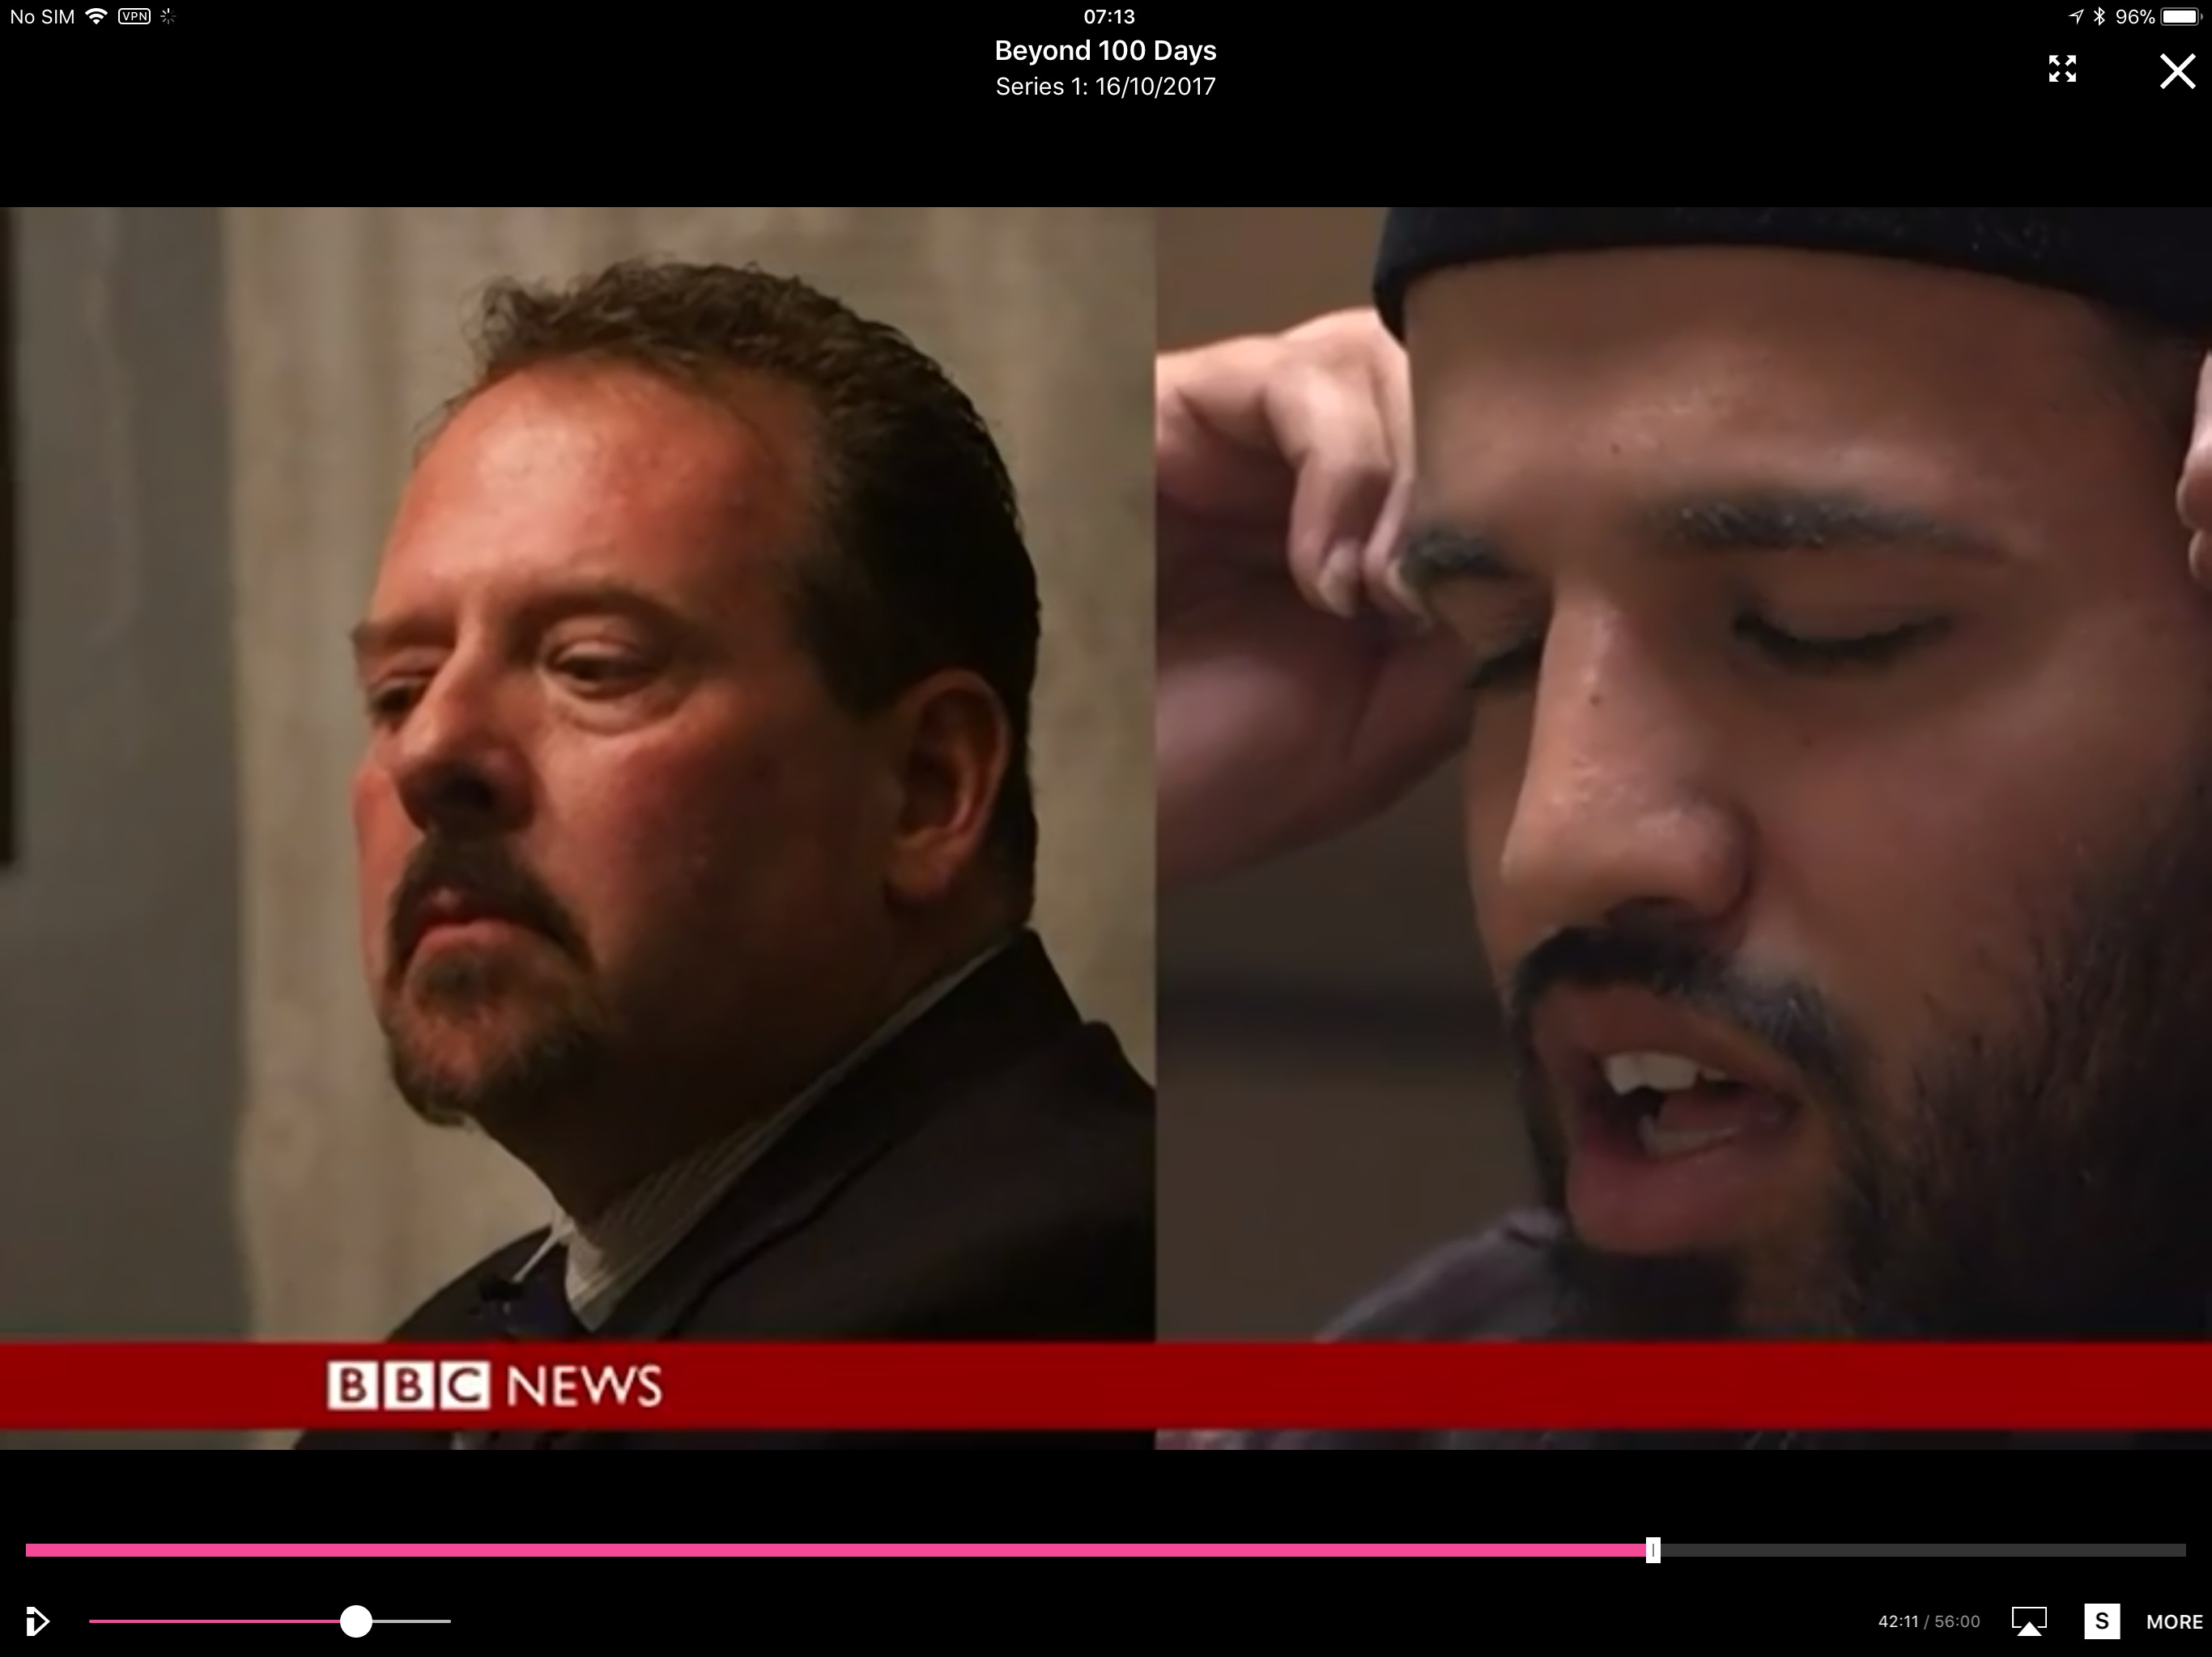
Cyber Superiority: Example – Counter Speech
Fight Against Hate
Ted Hackey & Leader of Connecticut Mosque
“And buying Facebook advertisements is much cheaper than an F-35 jet”
US Senator Mark Warner
https://ent.siteintelgroup.com
For Society: At the Cyber-Terrorist Level
For Nations: the geo-political level
Extreme Dialogue
Learning (rapidly) how we use Social Media in Counter-Speech
Understand Social Media &
Counter-Speech

Slide 9
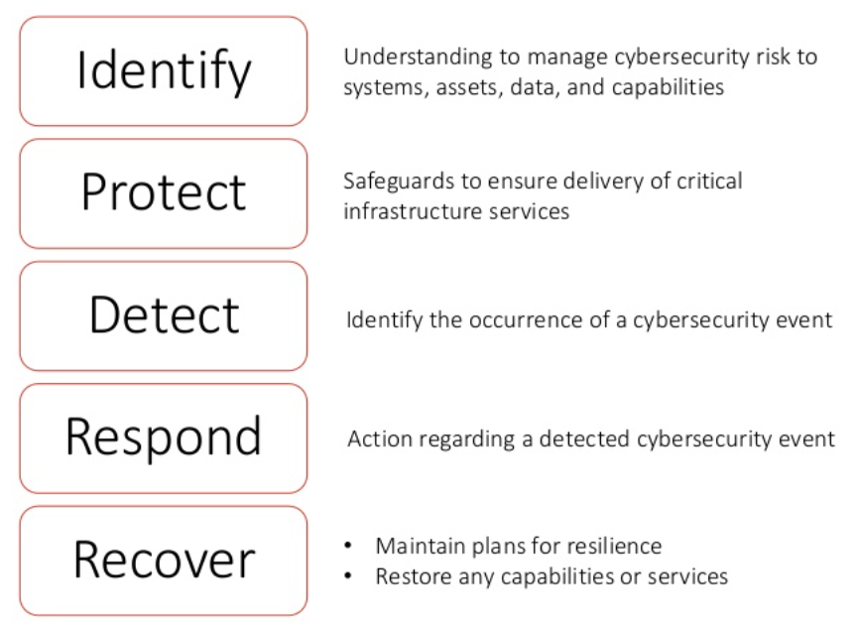
Cyber Superiority: Example - defend our Information Infrastructure
In 2016 "cybercrime cost the global economy over $450 billion,
over 2 billion personal records were stolen and in the U.S. alone
over 100 million had their medical records stolen,”
Work on what you do know:
Finger-print the code, executables, and scripts that are trusted on your network, enterprise or laptop
Malware/Ransome/Virsus can’t run – the TrustedApps approach
For Enterprises: At the criminal Level
For Society: At the Cyber-Terrorist Level
More Emphasis on Defending our Information Infrastructure

Slide 10
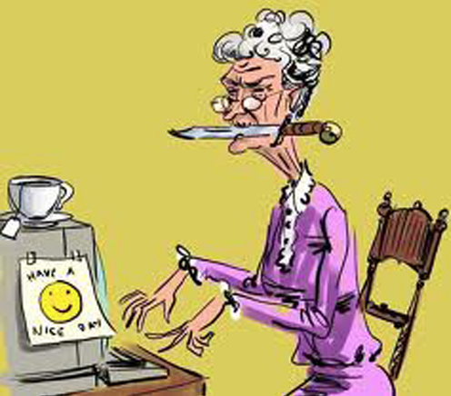
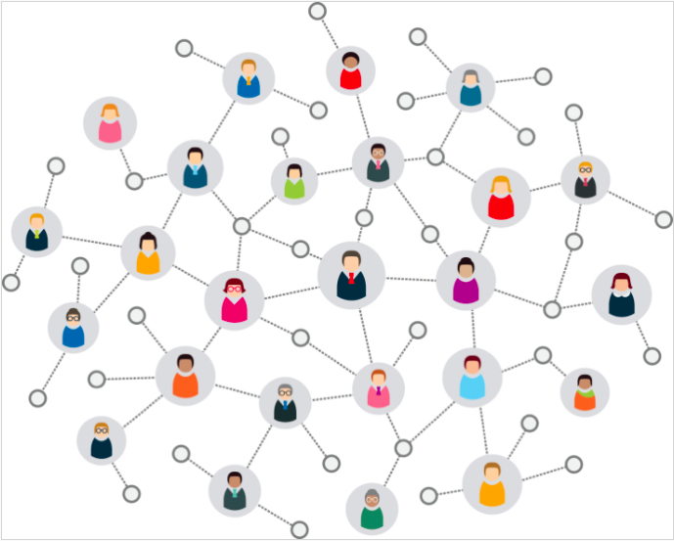
Cyber Superiority: Example – Know Your Customer
In 2016 "cybercrime cost the global economy over $450 billion,
over 2 billion personal records were stolen and in the U.S. alone
over 100 million had their medical records stolen,”
Removing Social Media content is a small step: Know Your Customer is a better goal
For Enterprises: At the criminal Level
For Society: At the Cyber-Terrorist Level
More Emphasis on Defending our Information Infrastructure
https://sites.duke.edu/lucasfaganblockchain/the-blockchain-for-ecommerce/

Slide 11
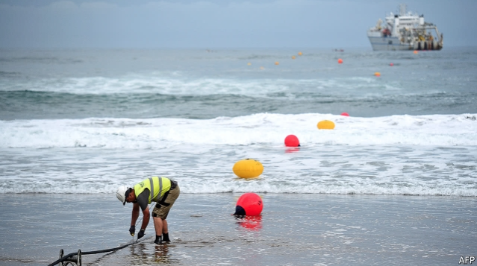
Cyber Superiority: Example – Know Your Customer
In 2016 "cybercrime cost the global economy over $450 billion,
over 2 billion personal records were stolen and in the U.S. alone
over 100 million had their medical records stolen,”
Completed Sep21st this 6,600km bundle of fiber-optic threads, is the highest-capacity connection across the Atlantic - capable of transferring 160 terabits per second
Owned by Facebook and Microsoft
Removing Social Media content is a small step: Know Your Customer is a better goal
…… Social Media Platform providers should be regulated !!
“Tech giants are building their own undersea fiber-optic networks” Economist Oct 2017 Issue
For Enterprises: At the criminal Level
For Society: At the Cyber-Terrorist Level
More Emphasis on Defending our Information Infrastructure

Slide 12
In Summary
In closing .. a few thoughts:
Cyber Superiority – unlikely in the medium term – which means:
A Defensive Stance - To protect our systems – eg Trusted Applications
Engage in Social Media with Counter Dialogue
Social Media market now mature – it is time that they get to know their customers & invest in the technology they need to do it
A Centre of Excellence in Social Media and CyberTerrorism
A combinations of research skills from social, humanitarian, political, technical
Orchestrate research to develop the skills, tools and techniques
Every organization, country and region needs one as the focus for international collaboration on what is a global battle-space

