Slide 1
Provisioning C4I Systems with IoT Technology
C4I Systems and IoT for Critical Infrastructures
18 October 2017
Michael Papay, PhD
Vice President
Chief Information Security Officer
Northrop Grumman
Approved for public release
© 2017 Northrop Grumman Corp.

Slide 2
Discussion Topics
Protecting national critical infrastructure means effective use of IoT
Business continuity and crisis management rely on IoT
Consider security when integrating IoT

Slide 3
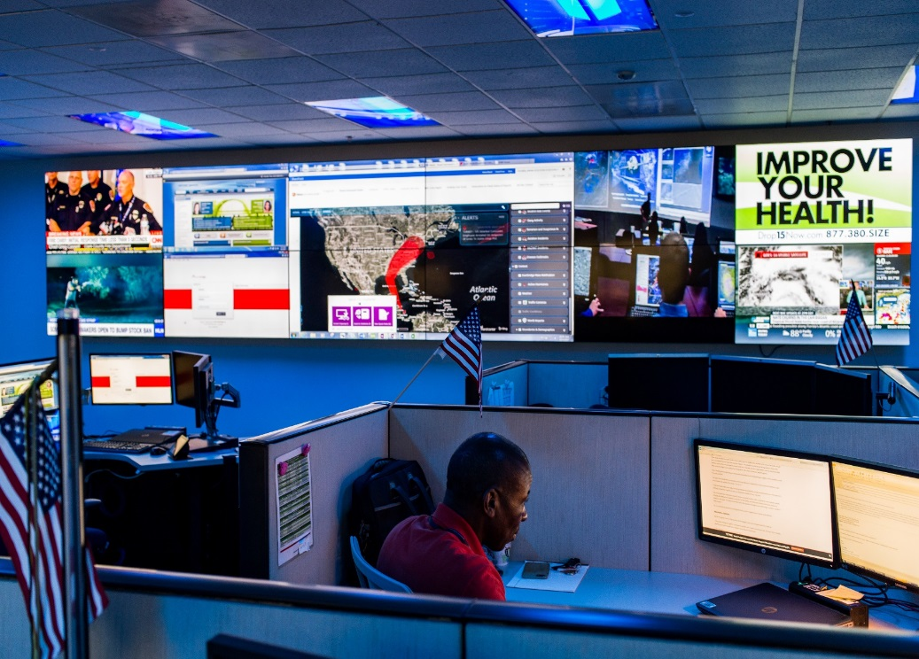
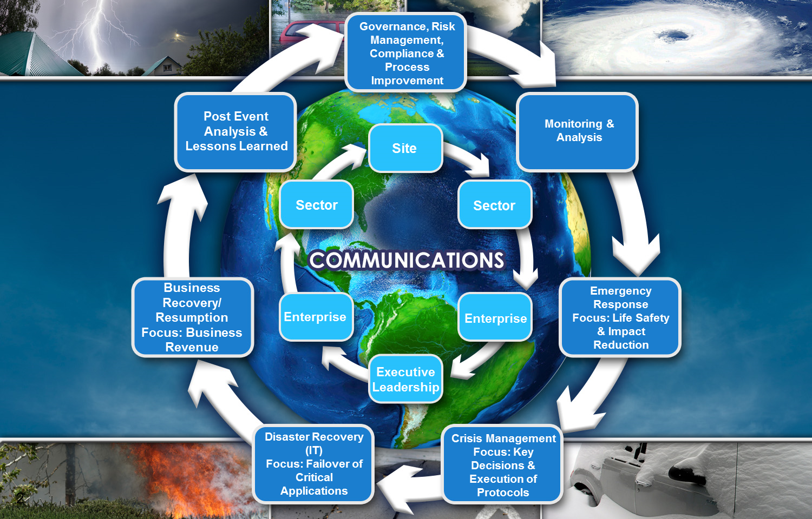
IoT: Business Continuity and Crisis Management
A significant number of IoT devices were called into action to ensure our employees were safe and secure
Cell phones
Satellite phones
Commercial services
Generators
Hurricane Irma struck Florida and the southeast US during the period of Sep 10-11

Slide 4
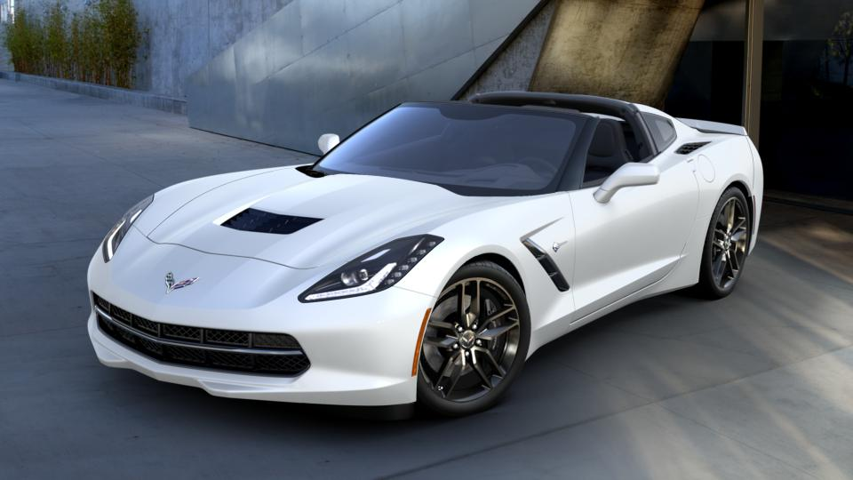
Consider Security when Integrating IoT
Performance Data Recorder
Supply Chain
Bluetooth/4G/OnStar
Keyless Entry
Remote Start
IoT Devices Integrated into a Transportation System

