Slide 1
How to Deliver Compliance and Security in the Cloud Generation World ?
Hunting in the shadow -- CASB
Wael Khalaf , Sr. Systems Engineer
Notes:
It’s a great pleasure and honor to participate to this great event.
Companies remain profitable , less cost by reducing operations
This influenced by economical situation
IT and security investment is capex
Cloud is the best solution to address these challenges

Slide 2
Agenda
To understand and dissect:
  Need for cloud application security
  Threats in cloud apps
  Compliance and security in Cloud
Cloud application threats – data exfiltration through document exposure
  Window of Exposure (WoE)
  Real world case studies
Platform driven approach using Data Science for Cloud apps security
  Understanding Data Science Techniques for detecting anomalies
  Threat detection and risk analysis
Conclusion
Notes:
Another advantage of cloud (SaaS and/or IaaS) predict expenses
Flexibility to grow , shrink and change
On the same time security become more challenge
Traditional security mechanism not tailored for cloud
Discuss (cloud trends, security and compliance challenge, how to address challenges independent of the service)

Slide 3

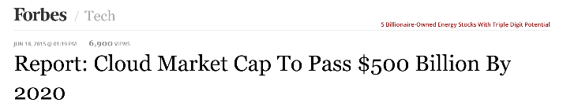
Market Demand for Cloud is Increasing
http://www.forbes.com/sites/alexkonrad/2015/06/18/byron-deeter-state-of-the-cloud/
http://openviewpartners.com/news/global-cloud-computing-services-market-to-reach-us127-billion-by-2017-according-to-new-report-by-global-industry-analysts-inc/
Notes:
As discussed cloud use and computing is rising and will keep on growing in the coming years.
There’s no way back if we want to stay competitive in our business.
This trend is confirmed by many analysists,
Surveys says many CIOs is going with this direction for the same mentioned reasons

Slide 4
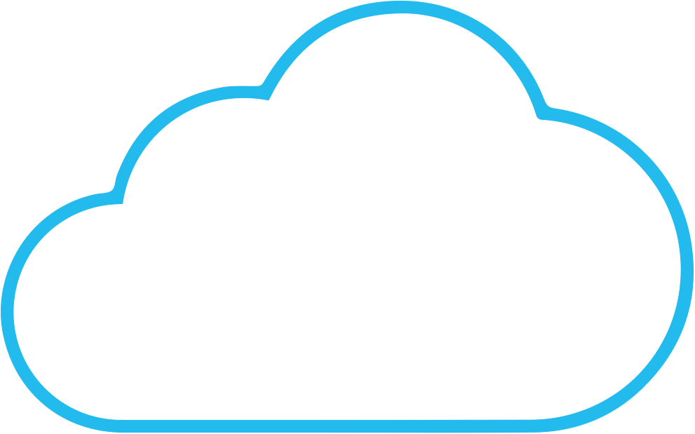
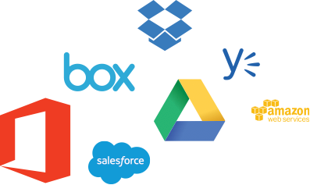
Reality of Technology World
Every time you opt for new technology, you have to secure it.
AV
F W
You wouldn’t run your business without email...
As business adopts cloud apps...
…and you wouldn’t use email without security
...you must secure them
Notes:
Technology Shifts were accompanied with Security Technology shifts as well.
we would not run our business without e-mail, we would not use e-mail without security...
In other words, now that our applications and resources are no longer in our data center and on-premise, we need a new level of security as well.

Slide 5


Why Cloud Apps Security is required ?
Notes:
And yes we need security as well as compliance layers on top of our cloud use.
Access to the applications and data is no longer restricted by DC walls and perimeters.
Cloud providers will build better security
However end-users will become target to recover passwords

Slide 6
Understanding Compliance and Security
Notes:
Talking about security only is not enough. Cloud use also introduces other challenges like compliance and governance.

Slide 7

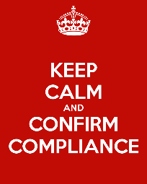

Compliance and Security
There is a difference between Security and Compliance in the Cloud!
Notes:
Compliance certainly is not the same a security… You could perfectly adhere to security guidance and violate compliance.

Slide 8

Are client records being shared publicly?
Notes:
An example is that we could follow the right procedure to share documents with our customers or partners.
If we however share inapropriate data securely, it does not mean we are compliant as well...
Different business have different compliance rules.
Its easier to share files in cloud than on-premise , this should be taken into consideration

Slide 9
Compliance vs. Security : Facts
Compliance is not same as security
Meeting compliance is not going to cover all the security needs
Compliance is not a blueprint for designing security controls
Compliance is a “demonstration” function to meet specific security standard
Compliance provides a minimum baseline for preventing threats
Compliance should never be the source of security programs but should be a byproduct
Notes:
READ SLIDE
We also could share the right data with the right user/organisation, but using an insecure medium...
In other words, security mechanisms should not be driven by compliance needs, but support compliance objectives.

Slide 10

Who is accessing your cloud data?
Notes:
When securing Cloud, we have to look at other mechanisms and identity validation is one of these. Much like with boarder security, we are looking at new mechanisms to ensure that the user name, to which access rights and authorization levels are linked, is used by the right user and not by an attacker or a malicious insider.
The types of identity theft or abuse we see today are
Compromised credentials by
Phishing attacks or stolen credentials
Targeted Malware which
Hijack employee’s valid HTTPS session (Zeus type of malware)
Malicious Insider

Slide 11
Security and Compliance in Cloud
What needs to be considered from security perspective?
  Data classification and visibility
  Secure movement of data at rest or in motion between public and private clouds
  Authorization and Authentication controls for data access and sharing
  Policies for Auditing, Monitoring, Incident Response and assessments
  Lifecycle management of SaaS applications in multi-tenant environments
  Threats lurking around cloud apps including Data Exfiltration, Data Destruction, Account Hijacking, Malware, etc.
Notes:
So what do we need to look at when we talk about secuirty.
A first and very important, yet very difficult topic is data classification and insight in what is happening with that data.
DLP projects have always been very difficult projects as often too many parameters play… What needs to be classified, how, what will happen witht it...
The most difficult one certainly is the ‘how’ as technology was limited in automatically classifying content... Often this was an error prone manual task.
Next we need to look at how data is traversing between trusted places and users, on or of premise, in public or private clouds.
As discussed seconds ago, proper authentication and authorization becomes a prime target.
→ It should be 1 and the same for all cloud...
Requires proper selection of the cloud tools as you cannot rely on integrated OS or AD integration at all times
Defining proper classification, encryption and access management is not enough.
You need re-assurance and as such, you should deploy proper auditing and Incident Response tools as well.
Furthermore we also need to look at lifecycle management of SaaS both for continuation and retention but also migration points of view.
The final item to closely look into are the more traditional threats trying to exfiltrate or destruct data or gain malicious access to corporate data.

Slide 12
Understanding Threats in Cloud Apps
Sensitive data exposure and information leakage
  Data exfiltration and data destruction
    On top of data exposure on itself which is more compliance related
Account hijacking via credentials stealing
  Sophisticated malware installed on end-user machines
    Man-in-the-Browser (MitB)
    Man-in-the-Cloud (MitC) attacks (on file sync agents)
  Spear Phishing attacks
  Inherent vulnerabilities in cloud apps
Abuse of cloud apps and associated infrastructure
Notes:
The threats targeting cloud data are easy to describe and are not new in itself.
In essence, we have always deployed security mechanisms to protect our data in our Data Centers.
It’s not about user or device protection itself.
Data security is top of mind, next to data exposure.
Well known techniques, often used to target banking web sites, now more and more are also used towards SaaS.
Malware and Advanced Persistent Threats target our end-user devices.
The most known threat is the MitB, where an SSL session, setup by the browser, is hijacked to perform malicious activity, hidden in an authorized SSL channel.
Now we also see more and more MitC attacks which are much more difficult to detect as they ‘malicious’ activity is very limited.
The target are ‘sync agents’ like with on-line file shares.
They keep track of what files are already synced between the device and the cloud storage.
The channel between the sync agent and the cloud service mostly is build using ‘SSL pinning’ techniques which prevent SSL interception and as such in-line security.
The MitC attack tries to steal the ‘token’ that is used to establish a secure channel as users don’t want to continously type passwords.
Once this token is collected, a new sync agent on the attacker’s system can be deployed with the token.
When you now save a new file, you not only sync it to the cloud, but also to the other sync agent on the attacker’s system.
At this time, no malicious activity or code is running, making it difficult to detect.
Furhter more we of course also still need to consider the phishing and classic vulnerability risks.
What becomes obvious here is that CASB tools are not going to be the only mechanism to secure cloud.
Actually what we are seeing today is a chaos of cloud security tools, all tackling a small part, yet making overall management of security and assurance very difficult.
It’s important that companies like Blue Coat are integrating CASB tools in a wider security architecture to leverage existing threat intelligence to identify:
Know bad sources, files and destinations
Re-use malware and sandboxing technologies
Share newly detected malicious files/sites quickly with the entire network and community
Integrate security analytics…
Etc.

Slide 13
Real World Case Studies
Data Exfiltration
Notes:
Now let’s have a look at some of the challenges we have seen when using Cloud.

Slide 14


Case Study : Data Exfiltration via Cloud Apps
Notes:
A big challenge has been unwanted data leaking or exfiltration through Cloud Apps.
https://www.elastica.net/2015/06/government-agency-passwords-exposed-via-google-drive/
https://www.elastica.net/2015/06/case-study-government-postal-service-agency-passwords-document-exposed-publicly/
An Indian government organization lost track of a password file which made it’s way to a publicly shared Google Drive folder.
As such, the password was available openly on the Internet.
In another security incident an error lead to exposure of a database containing 1.5 million private medical reports on Amazon’s cloud computing platform.
A subcontractor managing security claims handled access controls inaccurately, leaving it open to unapproved access.
http://gizmodo.com/security-hell-private-medical-data-of-over-1-5-million-1731548110
What this shows is that you cannot rely on the security mechanisms offered by the SaaS or the common sense of users.
You need to keep an eye on the exposure of your documents through 3rd party tools that are aware of content and risk of exposed files.
There’s different flavors of exposure. One is easier to address than the other…

Slide 15
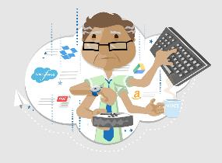
Case Study : Reasons for Data Exfiltration
An accidental mistake by the employee or administrator:
  loose shares – set to “all company” or shared “publicly” to save time
  did legacy sharing – forgotten shares still in place
  did inadvertent sharing – inherited file and folder permissions
Notes:
Errors are the most common reason for inappropriate data exfiltration and exposure.
Share is set with a too large scope (all company or public instead of individual users/groups)
Share is not ‘removed’ after the original goals was served
A file is added to a folder already shared, but too broadly
There’s no need for malware or intrusion detection tools or signatures.
The need is to properly map exposures vs content/risk and monitor/alert and remediate on this.

Slide 16

Case Study : Reasons for Data Exfiltration
A malicious insider shared the file with someone sitting remotely and
  did not remove the access permissions of the file intentionally
  spitefully shared the file publicly and exposed it on the Internet
Notes:
A more complex, but less existing reason for data exfiltration is caused by malicious insiders.
These are employees who have bad intentions.
Simply to harm the company or when leaking data to competitors as part of an exist strategy.
In this case the user is intentionally exposing data with broad access permissions, either in time or qua audience.
Similar actions are required to detect the exposure as for the previous case, but in combination with behavior analysis to identify the suspicious activity level of the user account.

Slide 17

Case Study : Reasons for Data Exfiltration
An attacker used the stolen credentials to share the file publicly to:
    provide access to other attackers
    obtain access for himself later
    data exfiltration by regular means is hard, so exposing file is easy way
Notes:
The most severe level of unwanted data exposure or exfiltration is caused by attackers.
As discussed earlier, there’s different methods for attackers to get access to apps and data.
The reasons to target cloud apps are divers as you actually don’t need to get the data on your system.
You could simply expose it from the original system so you can share with other malicious users or retain access for later.

Slide 18
Window of Exposure
Notes:
The typical problem described in all 3 use case scenarios is that data is exposed. As such, there’s a window of exposure.

Slide 19
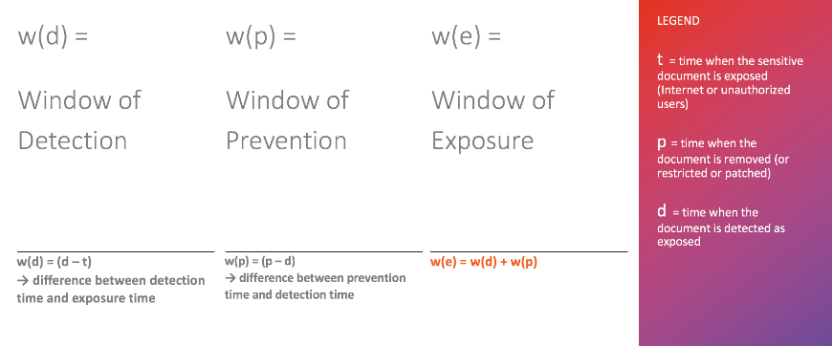
Understanding Window of Exposure
Notes:
Similar to on premise attacks , attack is still active until its discovered , and remediated
So what’s that Window of Exposure all about.
It’s a combination of states.
We start with the fact that a file is exposed.
Detecting that the file is exposed triggers the Window of Detection which is the first state and combines the time of detection with the time of original exposure to determine how long the file was exposed.
The next step is to mitigate the problem by calculating the time between the earlier detection and the time to remediate the exposure.
If you add both time frames to each other, you get the total window of exposure.

Slide 20

Window of Exposure
EXPOSED
DETECTED
PREVENTED
w(d) = Window of Detection
w(p) = Window of Prevention
time
w(e) = Window of Exposure
Vulnerable to Attackers Until Prevented
Notes:
When we put these states on a time line, we get a much better understanding of the total scope of the window of Exposure.
The Window of Exposure also is the ‘dangerous’ period as in that time frame the data is vulnerable.

Slide 21

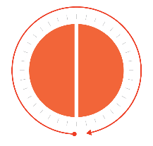
Window of Exposure
Enterprises are more prone to risks if w(e) is high because…
  either w(d) or w(p) are high
  both w(d) and w(p) are high
Without Cloud Access Security Broker (CASB)
Cloud Access Security Broker (CASB)
w(d)
w(p)
w(e) is high
w(e) is minimized
Notes:
Mitigation sometimes is easier said than done.
A company is certainly vulnerable if they have high windows of detection and/or protection.
If you have thousands, maybe millions of files without any automated tools to detect possible (inappropriate) exposures, the window of exposure might be long or sometimes almost forever.
We see that companies that introduce CASB solutions, drastically reduce the window of exposure by either addressing the window of detection through automated tools or even the prevention or remediation as well.

Slide 22
Platform Driven Approach using Data Science for Securing Cloud Apps
Notes:
How can we get to automation to tackle the window of exposure problem…

Slide 23
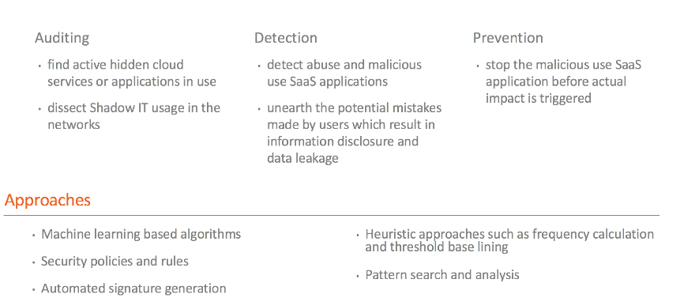
Platform driven Approach for Cloud App Security
Notes:
This is only possible through a platform driven approach, tackling the larger cloud security problem.
These mechanisms involve both traditional threat detection capabilities as well as more recent tools like CASB.
Today we focus on CASB, but when you select a CASB tool, make sure to look at integrating that tool with other security tools.
That’s where you’ll see the real benefit of a security company like Blue Coat tackling a broad range of security challenges vs. a nich CASB player or 3rd party integration with CASB.
CASB itself primarily should focus on your SaaS, not on more consumer based cloud tools.
In this setting, CASB should be a full life cycle management solution that can be used to determine possibly exposure to unsanctioned SaaS and Shadow IT by running a proper Audit.
The audit will list what is used, but at the same time will give insight in the desire of the users in your organization to use business tools.
The result is that Audit research can help selecting the right SaaS tool for your organization and to close loop the Shadow IT problem through integrations with your perimeter tools, like your ProxySG, to prevent access to unsanctioned SaaS.
The next step is to detect suspicious activity and exposure in your cloud use.
Finally you need to have tools at hand to safely enable your cloud solution through 3rd party policy mechanism powering an monitoring and control layer.
Approaches to deliver these capabilities are diverse and cover data science tools, automation as well as threshold based pattern or behavior analysis.

Slide 24
Existing Security Challenges for Cloud Apps
Shadow IT/Data - large number of unknown cloud apps
Manual efforts cannot scale to audit Cloud apps
Managing audit data for large set of applications
Lack of automation tools to address issues in cloud apps
Time constraints in completing audit tasks, released reports, etc.
What is the answer to these real world problems ?
Notes:
When we look at the challenges, it’s not difficult to understand the ‘big data’ issue related to limited resources.
We mostly don’t know what our users are using or what our business line manager have procured as many of those tools will be allowed by the existing perimeter infrastructure as they would match the ‘allowed’ ’business’ classification on app or URL filtering tools.
Manual tools will not be sufficient due too scale of:
Number of apps to be reviewed
Level of parameters to review per app
Automation will help to overcome the scale and time constraints.

Slide 25
Solving Cloud Apps Challenges
DATA SCIENCE
Notes:
Automation powered by Data Science. That’s the way forward.

Slide 26
Data Science for Cloud Apps
Analyzing Content in the Cloud
  Machine Learning for data analysis : extending DLP to the next level
  Contextual analysis of the data: leveraging data granularity
  Out-of-box detection of sensitive content: detecting leakages PII / PHI / PCI
  Robust identification of encrypted files: filtering data
Notes:
Data Science is on data in Cloud Apps will help on different levels to classify the documents by using machine learning tools and contextual analysis overcoming keyword matching and regular expression detection limitations and false positives.
Pre-defined classifiers will ease the process and kick-start the classification process whilst allowing for custom detection definitions.

Slide 27
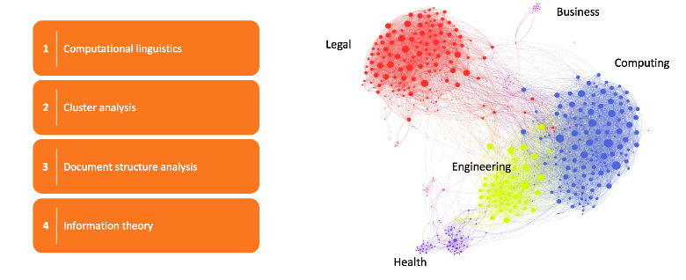
Data Science for Cloud Apps
Deep Content Inspection (DCI)
Notes:
Deep Content Inspection based Data Science uses different techniques to help in data classification related to security and compliance needs.
Not only look at words, but look broader and use natural language processing to analyse documents.
Understand structures of files and determine equalities during the learning process in processing files of the same type, fed to the system.

Slide 28
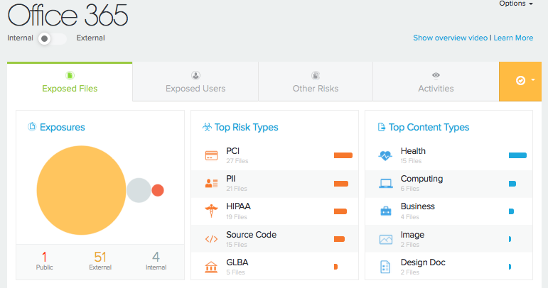
Notes:
Once the files are classified, exposure alerts make much more sense.
You’ll be able to check not only for an exposed ‘unknown’ file, but for well known types of files vs the type of exposure.

Slide 29
Data Science for Cloud Apps
Traffic flows and analysis
Notes:
The next step is to use Data Science not only to classify data, but also to find suspicious access and behavior of user accounts in your cloud apps.

Slide 30
Data Science for Cloud Apps
Event Identification inside SaaS to Track User Activity (StreamIQ)
  Analyzing SaaS applications network traffic data for extracting granular information
  Automating the process of generating “Activity Signatures” for users
  Machine learning algorithms are used for “Event Identification”
  Testing “Activity Signatures” against known data sets
  Deploying signatures for detecting real-time user activity in cloud
Notes:
Data Science will help building normal behavior patterns on a per (unique) user account basis.
Event identification mechanisms (in-line or out of band) can help in tracking user account activity.
Automation will help in collecting, normalizing and processing the data.
Furthermore behavior models will help to profile activity signatures or normal behavior and can flag suspicious activity and/or behavior.
The result is that user account compromises can be detected based on activity monitoring that’s out of range of normal behavior.

Slide 31
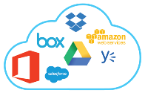



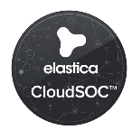




Monitoring and Control of Cloud Apps
API
Notes:
The question often is on how to collect that data.
Multiple mechanisms exist.
The easy one, not requiring any change or configuration of your network or end-user devices leverages the API provided by Cloud Service Providers.
Transaction logs can be data mined and files can be profiled.
The advantage is that this works for any device accessing the SaaS.
The disadvantage is that you’re relying on the quality of the events delivered through the API and the fact it’s an ‘after the fact’ situation, only allowing for remediation, not prevention.

Slide 32
Monitoring and Control of Cloud Apps
API
GATEWAY
Notes:
The second approach will intercept traffic before it reaches the SaaS.
The impact is that you need to control traffic steering and as such need control of the network and/or end-user device.
The advantage is that the security tool can see and determine the transaction levels themselves, often in more detail and could even prevent activity or enforce policy/protection/encryption.

Slide 33
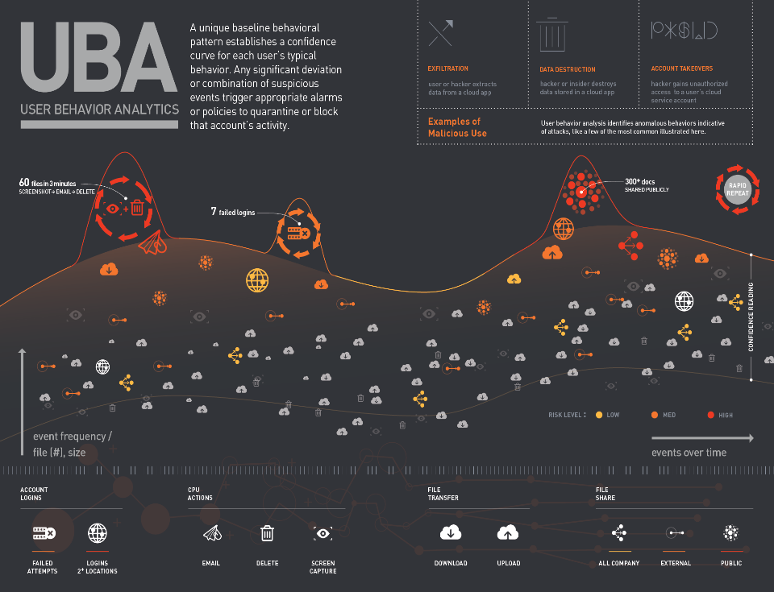
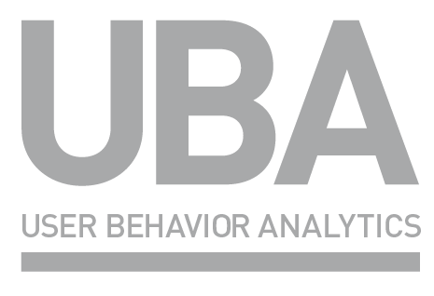
v
A unique baseline behavioral pattern establishes a confidence curve for each user’s typical behavior. Any significant deviation or combination of suspicious events trigger appropriate alarms or policies to quarantine or block that account’s activity.
Notes:
When we bring it all together, we can visualise UBA where the activity levels collected are processed by the data science engine and deliver a usage graph or pattern.
We can determine simple things like failed logins… But still more accurate than the built-in SaaS detection as it’s correlated over all SaaS usage, even when only when failed login per SaaS happened.
It’s more interesting to look at the sequence based detection. It all looks legitimate and is allowed for the user account, yet if you see spikes of sequences in short time frames, without having to specifically define those sequences.
Example:
For most user accounts, it won’t be normal that witin minutes over 60 times, a file is copied, the copied file is shared and quickly deleted.
Or an account only had an aveage of sharing 2 or 3 files a day and now suddenly that account shares more than 300 docs...

Slide 34
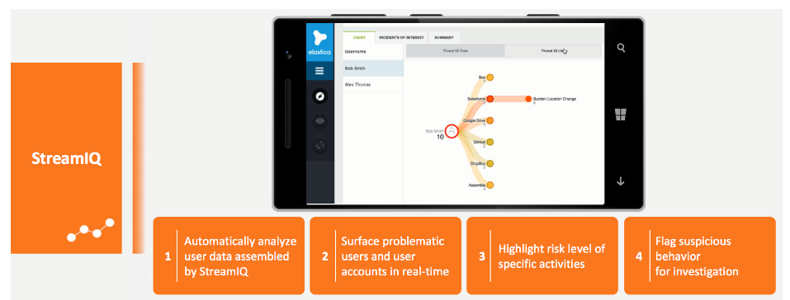
Data Science for Cloud Apps
Notes:
The result of the data science detection is a threatscore per user, visualised as a graph view.
This visualization helps to quickly zoom into problem topics, with limited man power and research time.
Highlighted issues can be further analyzed through integrated data mining.
High ThreatScores can be used as a trigger for policies so that normal sharing operations can be performed, except by user accounts that have a triggered an elevated ThreatScore or in other words, level of suspiciouness.

Slide 35
Conclusions
Notes:
To wrap this up, we can conclude that integrated cloud security approach is required, on top of CASB only.

Slide 36







API
Company Accounts
SECURED THROUGH
GATEWAY AND APP APIs
Cloud Apps
Sanctioned
Apps
Personal Accounts
SECURED THROUGH
GATEWAY
GATEWAY
CloudSOC
Apps to Monitor
SECURED THROUGH
GATEWAY
LOGS
Unsanctioned
Apps
CloudSOC
Agent
Apps to Block
FINE TUNE WEB PROXIES AND
FIREWALLS; BLOCK APPS
Enterprise Perimeter
Notes:
A road map to deliver comprohensive Cloud Security is as follows:
Use your existing proxy or firewall logs to perform your first risk analysis.
Audit will help you to come up with a list of sanctioned and unsanctioned Apps.
This is where standalone CASB solution already get into trouble, as reporting is one, follow-up on the report is two
With Blue Coat you can now close the loop again with your existing ProxySG (or SWG) deployment to restrict access to unsanctioned Apps automatically as the same AppFeed available in the report also is available to the policy engine of the ProxySG
What is allowed on the ProxySG will be screened/monitored for malware (urls and files) and APT related items
The next step is to use the advanced capabilities of CASB to secure and monitor your SaaS environment.
Sanctioned Apps are allowed and can be screened through either API or GW enabled event extraction
And even here, you’ll immediately see the benefit of an integrated CASB solution as allowing Sanctioned SaaS, also allows using that SaaS with personal accounts.
CASB can help to screen for inappropriate exfiltration of corporate or sensitive data through the personal account
Last but not least, we can even address to most difficult situation where we have identified unsanctioned Apps that have been very popular and could not be blocked as such.
The CASB can now help to secure these ‘gray’ apps, until they can be sanctioned or replaced by sanctioned apps delivering the same capabilities.
Once CASB can screen the different apps, detection of threats, remediation of incidents and monitoring of activity can be performed.

Slide 37
Conclusion
Cloud applications are encountering threats from:
  Employees (unintentional) | Malicious Insiders (intentional) | Attackers (intentional)
Potential steps towards securing cloud apps:
  Need for complete platform-driven CASB solution that:
    uses Data Science as an underlying technology to implement advance techniques
    unveils Shadow IT usage in the networks
    dissects layer-by-layer user activity in the cloud
    detects anomalies and threats in cloud
    enables auditors to implement protective measures
  Use of reputable cloud app
  Requirement of Decent Identity Management system (IDM)
Notes:
Finally we can conclude that securing cloud brings new challenges.
We need to enlarge the scope from internal to external and use different layers of inspection powered by data science and correlation to detect anomalies and exposures so that we can enable the need for SaaS driven by the business and as discussed in the beginning of this presentation in a save and compliant way…

Slide 38
Thanks.

