Slide 1
Keynote 9: Cyber Security in Emerging C4I Systems: Deployment and Implementation Perspectives By Eric J. Eifert, Sr. VP of DarkMatter’s Managed Security Services

Slide 2
Agenda
Background
Threat Actors and Risks
Case Study
Assessing Cyber Risk
Mitigating Cyber Risk

Slide 3
My Background
Over 20+ years experience in Cyber Security
Special Agent investigating cyber crime and computer intrusions
Programme Manager for large U.S. Cyber Security Operations Centres
Executive running cyber security line of business (US$125+M)
Adjunct professor teaching graduate cyber investigations
Relocated to UAE for DarkMatter

Slide 4
Who are the Threat Actors
World Trade / Globalisation Activists
Environmental Groups
Regional Political Activism
Non-State Sponsored Terrorism
Organised Crime
Nation States / Governments
Insider Threats
Information Hacktivisists
General Attacker Threats
Illegal Information Brokers and Freelance Agents
Trusted 3rd Parties
Corporate Intelligence
Investigation Companies
Competitors, Contractors, Corporations
Untrained Personnel

Slide 5
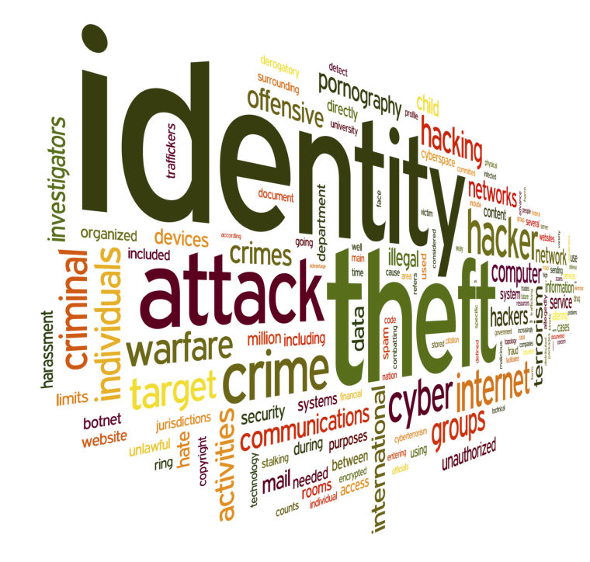
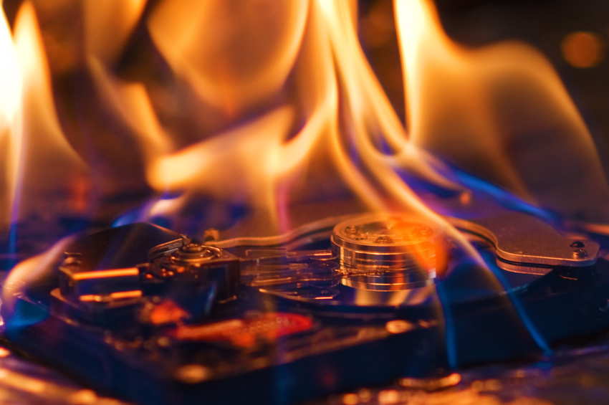
What are the cyber risks
Theft of sensitive and valuable information
Manipulation of mission critical data
Disruption to operations
Impact to successful execution of mission priorities
Destruction of C4I systems via non-kinetic attacks

Slide 6
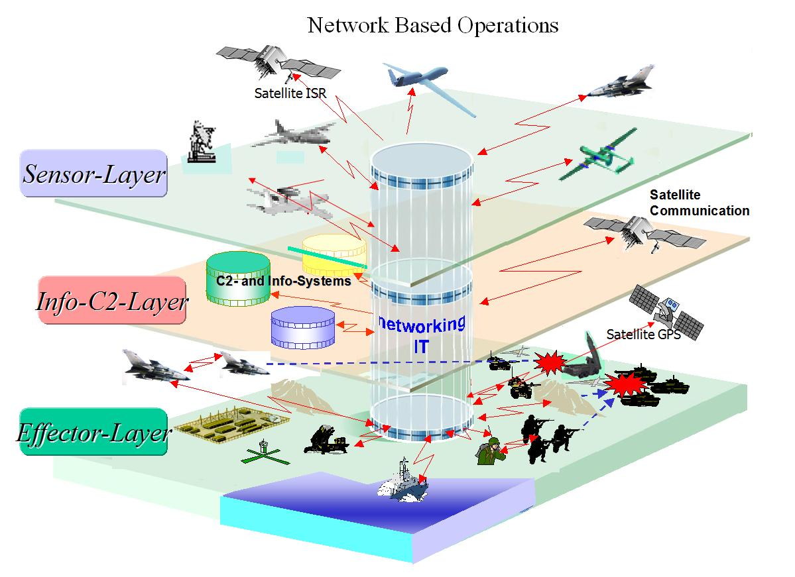
Knowledge is power
C4I System are complex and targets of sophisticated cyber attacks
What type of information are adversaries looking for?
C4I capabilities
Operational information
Vulnerabilities
Plans and strategy
Research and development

Slide 7
Well orchestrated cyber attack against Ukrainian power grid
23 Dec 2015 “Prykarpattyaoblenergo” reported disruption of power supply because of an “accident”
Ukrainian CERT reported 8 different power companies across 8 different regions were affected by cyber attacks
One company affected linked attack to subnetwork belonging to ISP operated in Russia

Slide 8
Multi-Pronged Attack
Disconnected breakers to substations
Telephone Denial of Service Attack
Manipulated monitoring capabilities
Destroyed corporate systems

Slide 9
C4I Systems
Deployable C4I capabilities
Mission critical systems
Long Haul Communications
Mission impact
Lessons learned

Slide 10
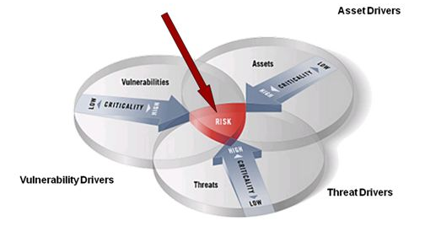
Assessing the risk
Understand your assets
Sensors
Communications
Network environment
Data Storage
Analytics
Understand the threats
Which threat actors are targeting you and why
Know their capabilities
Understand your vulnerabilities
People, process, and technology

Slide 11
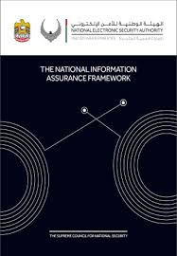
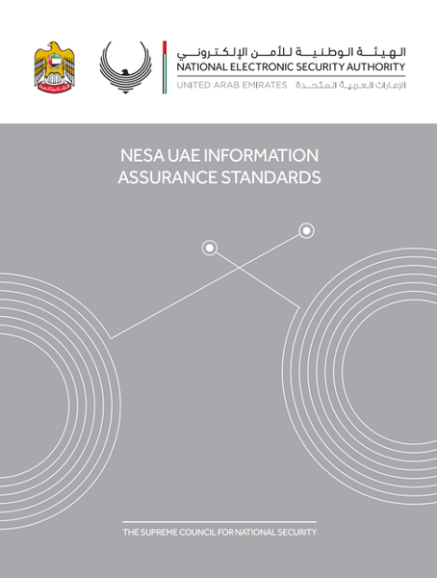
Assessing the risk
Identify standards to measure yourself against
Leverage guidance from your country and others
International Organisation for Standardisation
US National Institute of Standards and Technology
Industry specific documentation

Slide 12
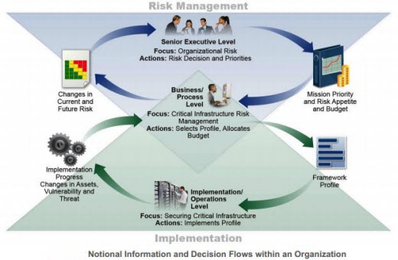
Assessing the risk
What to assess?
Risk Management
Asset, Change, and Configuration Management
Identity and Access Management
Threat and Vulnerability Management
Situational Awareness
Information Sharing and Communication
Event and Incident Response, COOP
Supply Chain and External Dependencies
Workforce Management
Cybersecurity Program Management
NIST’s model of security information and decision flows within an organization (Source: NIST Preliminary-Cybersecurity Framework, Page 9)

Slide 13
Mitigating the risk
Visibility
At the most basic level it is having true visibility across your own environment
Knowing what is on your network…
Knowing how your network is configured…
Knowing who is on your network…
Intelligence
At an intermediate level it is understanding external influences and their relevance to your environment
Integration
At an advanced level it is the integration of all this information to allow continuous monitoring and rapid decision making
Notes:
What is on your network includes hardware, software, and information.

Slide 14
Why Visibility
Visibility
Intelligence
Integration
Visibility Type | Rationale
Hardware | Knowing what hardware is in the environment as well as when new hardware is introduced to the environment allows you to ensure they conform with your secure baseline and are authorised devices
Software | Software vulnerabilities, bugs and security updates are common, knowing if you are vulnerable and rapidly resolving your vulnerable state is critical
Configuration | Maintaining a secure configuration baseline is important to prevent unauthorised access and subversion of defences
Identity and Access | Confirming the identity of authorised users as well as ensuring they have access to the appropriate resources and data sources
Data | Knowing what data within your organisation is sensitive allows you to focus your resources on what is most important

Slide 15
Why Intelligence
Visibility
Intelligence
Integration
Intelligence Type | Rationale
Vulnerabilities | Understanding what vulnerabilities exist within your environments as well as when new vulnerabilities are discovered allows for rapid remediation
Threat Actors | Understanding the types of adversaries targeting you and their motivation helps to focus resources and security investments
Adversarial Capabilities | Up to date knowledge of the specific tactics, techniques, procedures, and technologies being used by an adversary allows for better detection
Government | Government agencies have access to rich threat intelligence that can be leveraged to gain better insight into the threat landscape
Industry | Industry peer groups can provide insight into sector specific cyber threats as well as share lessons learned to increase your security posture

Slide 16
Why Integration
Visibility
Intelligence
Integration
Integration Type | Rationale
Diverse Technology | Proper integration of diverse technologies reduces the potential for the introduction of security weaknesses
Legacy Technology | Legacy applications running on insecure hardware and software need to be known and mitigated through other means
Logs and Diagnostics | Diverse log and diagnostic formats can make it difficult to leverage the content for decision making
Visualization | Aggregation of information into a dashboard for decision makers helps prioritise and speed up the decision making process
Automation | Acting at the speed of cyber to mitigate issues reduces the potential of cyber events

Slide 17
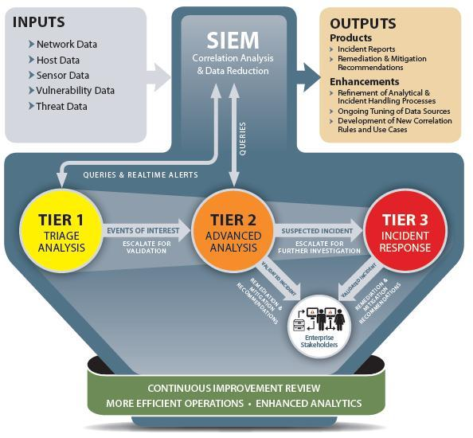
Mitigating the risk - Increase your visibility
Deploy technology to provide visibility across all assets
Remote locations
Non-IP based systems
Mobile and wireless
Understand your critical assets, technology, and data
Correlate and analyse data to detect anomalous and suspicious events
Conduct continuous monitoring and rapid remediation/mitigation activities

Slide 18
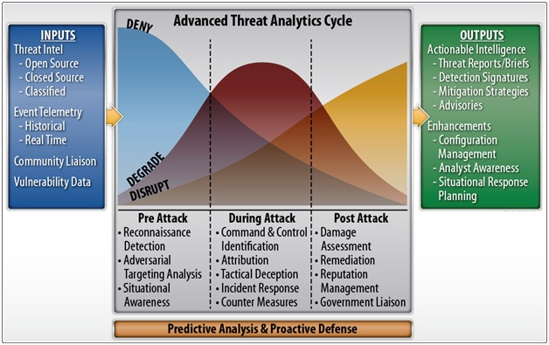
Mitigating the risk - Increase your intelligence
Develop a threat intelligence programme
Obtain threat intelligence feeds
Develop partnerships with government information sharing programmes
Develop partnerships with industry peers to share threat intelligence
Interface with all stakeholders to understand critical components

Slide 19
Mitigating the risk - Facilitate better integration
Understand the technical landscape within the organisation and influence the roadmap with a focus on better integration and security
Attend user conferences to learn about best practices from other organisations with similar environments
Develop a secure reference architecture that is flexible and adaptable
Understand the Application Program Interfaces (APIs) of the technologies in use and how to leverage them for security orchestration and automated remediation
Develop an integration lab to test secure configurations and integrations prior to deployment

Slide 20
Summary
C4I systems complex and a target for cyber attackers and insiders
In order to assess your cyber risk you need to understand your assets, the threats to those assets, and the vulnerabilities
Leverage National and International standards, guidelines, and frameworks
Evaluate your organisation’s cyber maturity across visibility, intelligence, and integration
Develop a plan to mitigate the highest risk areas and build towards a continuous monitoring and mitigation capability supported by intelligence and securely integrated technology
Visibility
Intelligence
Integration

