Slide 1
TOWARD A
GULF RESILIENCE READINESS CENTER
Enhanced Cybernetic Capability Through
CRISIS RESILIENCE INTEGRATION SUPPORT PLANNING (CRISP)
“from Challenges… to Opportunities…to Solutions”

Slide 2
Presented to
The International Conference on C4I Solutions 2017
Riyadh, Saudi Arabia
Dr. Walter L. Christman
Chairman, Global Challenges Forum Foundation

Slide 3
A New Era of Security Challenges…
Globalization has brought new challenges that appear to be beyond the ability of our current institutions to address
In response there is a need to generate new education and training opportunities on a global basis
This will allow the exploration of more partnership-oriented solutions to contemporary threats and risks
Cyber
Critical
Infrastructure
Energy
Economic
Environment
Human
Maritime
Defense

Slide 4
The Gulf Region Is At Risk …
In 1987, the GCC countries approved a comprehensive security strategy, in the form of a general framework for organizing cooperation to support mutual security. It covers cooperation in multiple aspects of defense and security.
Primary concerns: illicit trafficking, punishing and rehabilitating threat-based organizations, immigration, passports, airport security, drug fighting, weapons, explosives, border guards, coastal guards and civil defense

Slide 5
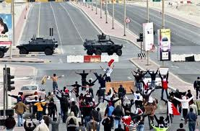
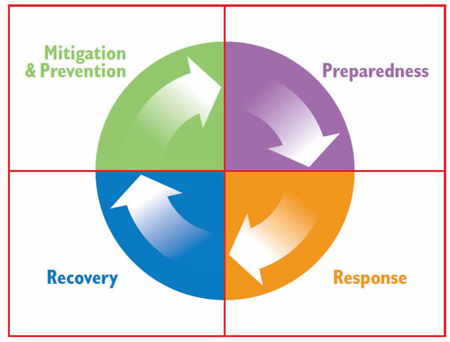
Challenge – Combatting Terrorism
When incidents grow in numbers and severity – a crisis situation is not far away
This is when you most need trained risk and crisis management organizations with allocated resources and procedures to manage the situation effectively, and depending on scale – the ability to work together
Organizations are at different levels of scale and maturity and readiness, which can have severe consequences!
Notes:
Additional points: A crucial issue will be how to manage and incorporate “open source” information and building into the system common data standards. HA/DR exercise missions can help teach how to accommodate social media and the 24/7 media cycle without need of scenario reference to political tensions or adversary nations.
GULFNET capabilities could be made available within individual national military services, jointly within nations, across nations within a specific mission area (like HA/DR or C-IED), or supportive of some level of combined multi-national ops. Make the net flexible enough to be tailored to national wishes within the GCC context. "Save the willing first."

Slide 6
Recommendations from Saudi Arabia 2016 C4I International Conference
Called for the creation of a specialized “Command and Control Systems and Solutions” National Center, achieving the Kingdom’s vision (2030) to support and develop the “Command and Control Systems”
The Proposed Center’s work would entail:
Supporting knowledge and technology transfer and local embedment
Supporting research and development with specialized academic and research entities at the local and international levels
Setting a roadmap for the development of current systems and identification of the main challenges facing development

Slide 7
Recommendations from Saudi Arabia 2016 C4I International Conference
“Creating a system of cooperation and complementarity among the command and control centers spread across the kingdom, including the centers of Ministries, Police, airports, ports, survey and geographical information systems’ centers, in order to unify their visions especially when it comes to joint matters and issues, to avoid having different solutions for the same matter.”

Slide 8
Drivers for an Appropriate Response
Hybrid threats are becoming the drivers of defense innovation
Case studies are required
Next-generation approaches to knowledge capture, sharing, and distribution are critical
Training, education, and exercises remain highly valuable and are key facets in developing regional relationships and partnerships
Need for a shared vision of the future transcending cultural and national barriers to promote a shared deterrent capability and counter-measures to Daesh information warfare aggression

Slide 9
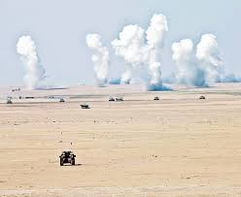
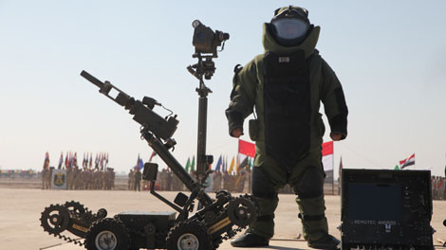
Opportunity
Most civilian and military organizations have to manage complex and interconnected operations in the event of a crisis
To minimize losses, casualties and to maintain trust and continuity, both common procedures and training are required
Network-connected simulated exercise scenarios can build shared readiness and capability
New approach to preparedness – Rapid Decisive Resilience
Notes:
Additional points:
Must recognize that technologies will never be enough. Exercises are required to build the social networks necessary to build trust. Need to make sure that policy and doctrine align with what people in the field know about so that they can properly execute. Must also rely on legal and regulatory regimes. Remember, there are no ”lessons learned” until behavior is changed.

Slide 10
An Arab World Global Visionary
Co-Founder and Honorary Chairman, Global Challenges Forum Foundation
Chairman, UN Global Alliance for ICT and Development
Arab World Leader for the Knowledge Society (IP, ICT, Education +)
Proposed Gulf Resilience Readiness Center concept at Abu Dhabi C4ISR Summit 2016
“Human experience throughout the ages has been enhanced through learning, information and communication. The information revolution will lead us through a knowledge revolution to the wisdom revolution.”
-- Talal Abu Ghazaleh

Slide 11
Solution
Establish Gulf Resilience Readiness Center to promote effective risk and crisis management through a Simulation Network
Lessons Identified/Learned by “others”
Evaluate all the relevant parts that need to be in place for a fully functioning risk and crisis management system
Build methods, models and capabilities to achieve Gulf-shared objectives and goals to support Cyber Resilience Integration Support Planning (CRISP)

Slide 12
Analyzing the Gaps
Education and Training Gap
Non-aligned efforts,
Pre-deployment Preparation
Discipline Interoperability Gap
Different organizational cultures, approaches
Institutional Gap
Processes to capture and
analyze data/lessons learned
Operational Picture Gap Lack of standardized, integrated information
How to synchronize and align efforts?
NGOs
GCC Governments
Practitioners
International Organizations
Partner Governments
Academics
Ops Space
Notes:
Gap Analysis:
Non-traditional Operations Space
Government/Development/Security
Many Actors – not synchronized

Slide 13
Joined to “Composable”’ C5 Environment
“C5 thinking” (Command, Control, Cooperation, Coordination, and Collaboration) is more appropriate to gaining “unity of effort” than “unity of command” terms like Command and Control and C4ISR
Components of the Composable C5 Environment:
Research, Analysis, and Reference Resource
Network of Educational Centers
Collaborative Information Sharing Framework
Social networks will link participants in an information sharing network and generate feedback to further the development of the GRCC Education and Training components
Collaboration Produces NEW Knowledge

Slide 14
Achieving Mutual Support
Collaboration
0
GCC Governments
NGOs
Practitioners
Interoperability
Engagement
Academics
International Organizations
Partner Governments
GRCC
Ops Space

Slide 15
Cyber Resilience Integration Support Planning (CRISP) is needed to:
Link U.S., European and Gulf support elements
Enhance training and exercise capability through cyber design inquiry to explore the art of the possible
Provide a distributed, secure test and training environment for resilience/deterrence capabilities
Enable “Red Team” engagement to help Gulf Partners to improve Cyber defense effectiveness
Lead to robust partner capacity development and response teams
Create a persistent cyber infrastructure to counter hostile operations

Slide 16
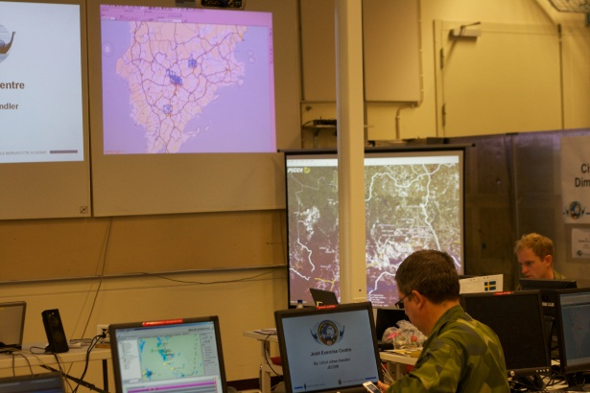
The Viking Exercise Concept As Example
Viking is the world’s premier distributed Civil-Military Computer Assisted Exercise
In VIKING 14; 2600 participants from 24 nations and 33 organizations
Took place in five different countries with Sweden as the lead nation
Real time Exercise Control
The exercise is a joint venture between Sweden and USA
20 years of continuous success in delivering a venue for Commander and Staff interoperability!

Slide 17
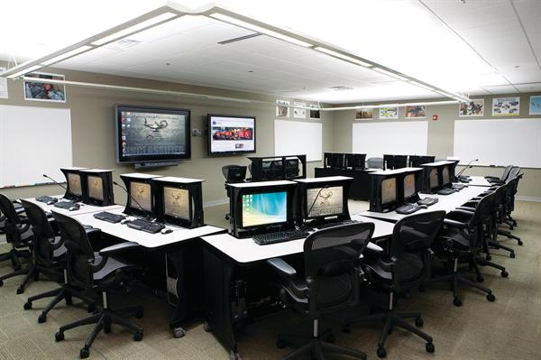
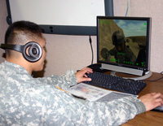
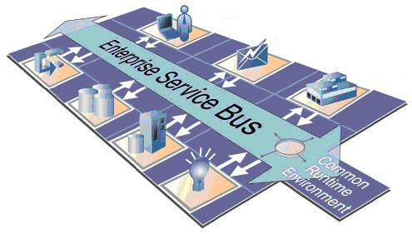
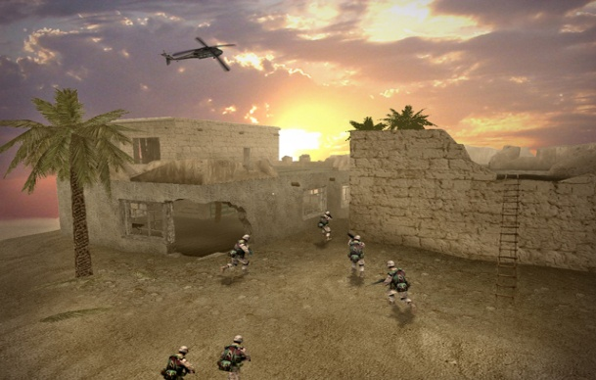
To enable an affordable and incremental build out of training and exercises capability under GRRC construct, it should employ:
Two Major Technology Components For Gulf Resilience Readiness Center (GRRC)
Cloud Technologies incorporate:
Virtualization
Data Center Management
Grid Computing
Service Oriented
Architecture
offers agility
in integration

Slide 18
Training Support Cloud
EXCON
Digital Cloud
Simulation Centers
Models
Constructive
Social Media
Terrain
AAR Tools
Scenarios
Weather
MSEL Tools
Response Cell
OOB
Network Control
News
Media
Intelligence
Training Audience
Command/Staffs
Virtual
Ranges
Training Centers
Live Platforms
Home Station

Slide 19
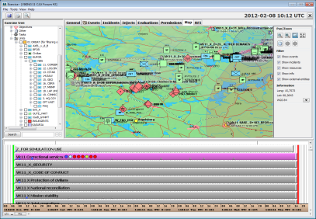
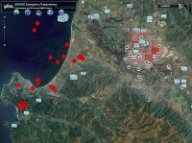
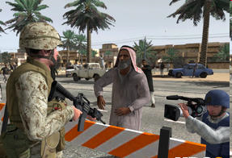
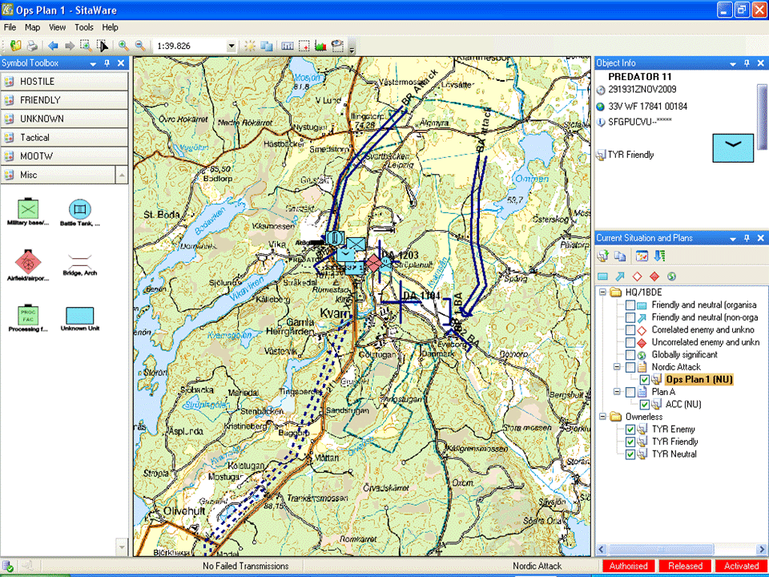
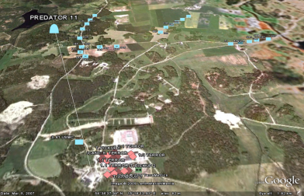
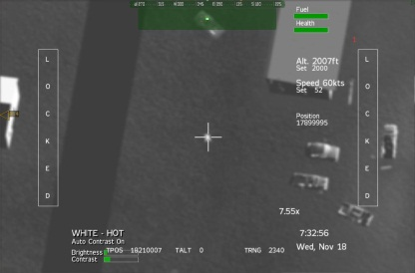
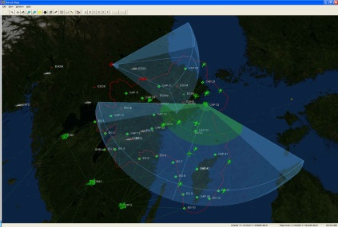
Exercise Management
Theater Level View
Constructive Simulation
Virtual Simulation
HLA-bridge
HLA-bridge
HLA-bridge
HLA-bridge
HLA RTI – Run Time Interface based on
the FOM – Federation Objective Model
Middle ware
Middle ware
HLA-bridge
HLA-bridge
Command & Control
Tactical Picture
UAV Simulation
Air Simulation

Slide 20
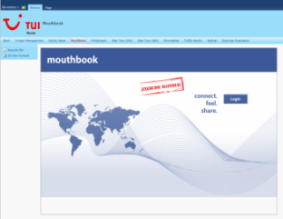
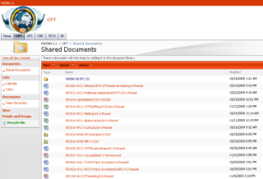
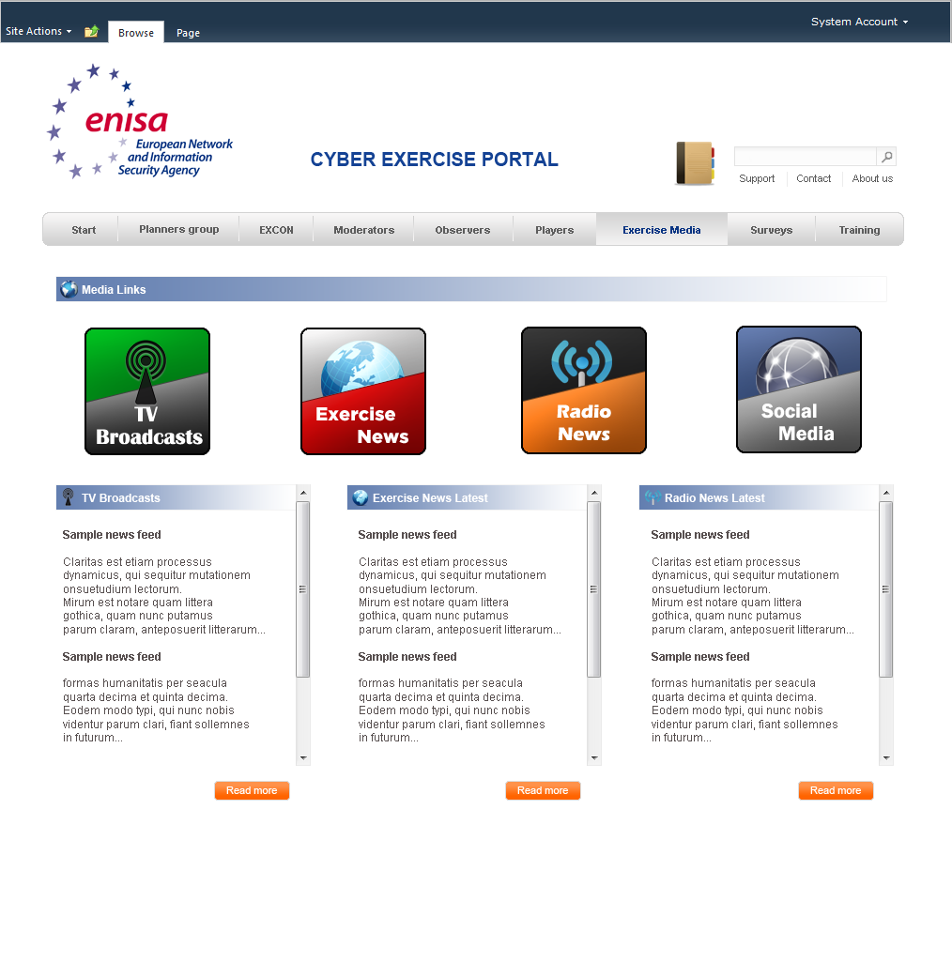
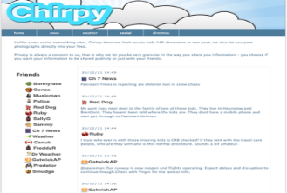
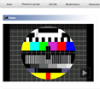
Enhanced by Collaborative Portal and Social Media
Mouthbook
Information
Management
Collaborative Portal
Chirpy
twitter
Event, Scenario & Exercise Management
Mission Planning
Web
News
WebTV&
Radio
Lessons Identified
Notes:
To succeed, GULFNET must get more than just the comms and connectivity right. The real issue not just technical interoperability, but cognitive interoperability. This concerns an active understanding of social networks and the sociology of civil-military interoperability to identify and combat emerging threats such as state-sponsored terrorism. HA/DR missions are ideal to help promote a unity of effort where unity of command is not possible.

Slide 21
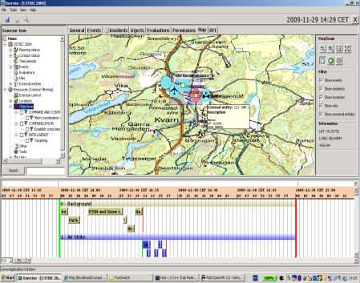
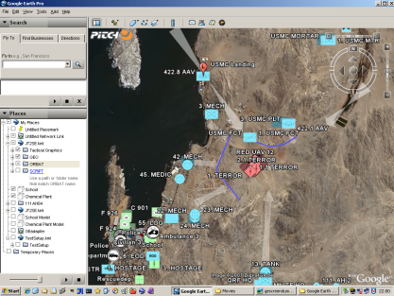
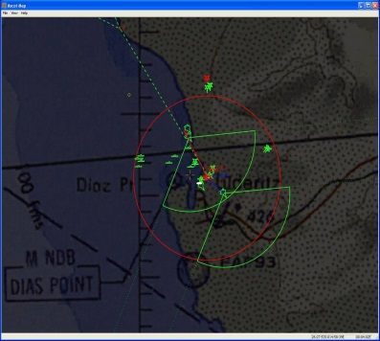
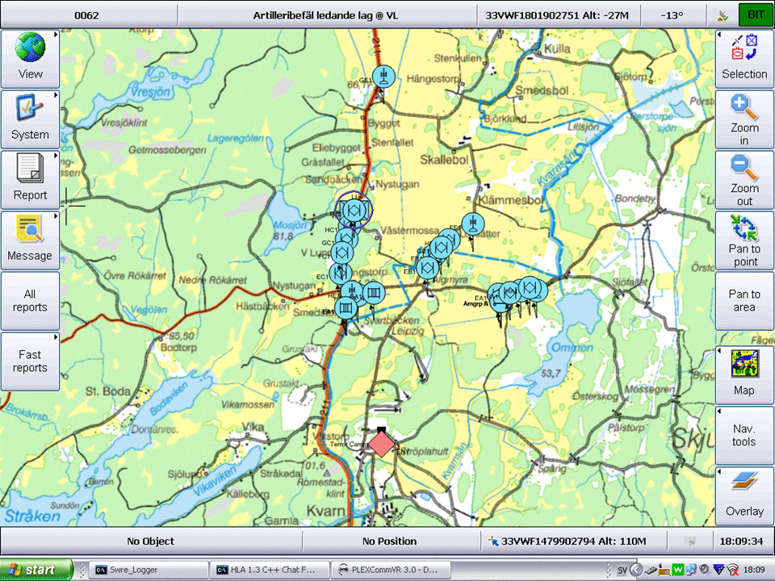
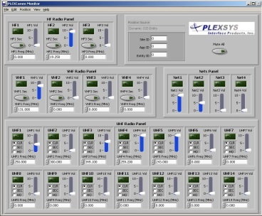
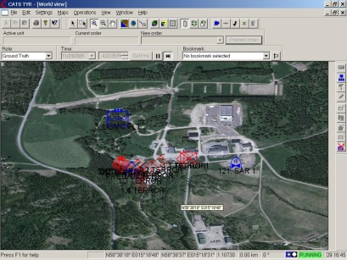
Results in Integrated Capabilities
ScenarioViewer
Collaborative portal
Exercise Management
Combat & Air C2 sim
GULFNET
FEDERATION (HLA IEEE 1516)
Tactical Picture
Voice & Radio sim
Operational/ Tactical Constructive sim
Virtual sim & 3D viewer

Slide 22
GRRC Promotes “Crisis Resilience Integration Support Planning (CRISP) Crisis Resilience Integration Support Planning
CRISP is an Education, Training and Simulation Network concept to address emerging security threats. It promotes:
A persistent network to link the interested Gulf member states to a sharable, distributed online exercise program, and….
Focuses on new and expanded security missions, including Combatting Terrorism and Humanitarian Assistance and Disaster Response (HA/DR) using “best of Web” technology to enable participation by leading institutions and individuals, by….
Taking advantage of an explosion of next generation training tools and designed to evolve as technology changes, primarily through….
Scenario-based thinking that ties together and integrates diplomacy, defense and security, as well development and humanitarian threads for holistic national security solutions leading to…..
Enhanced Gulf resilience readiness and interoperability

Slide 23
Crisis Resilience Integration
Support Planning (CRISP)
GRRC could be the primary method by which Crisis Resilience Integration Support Planning (CRISP) occurs.
GRRC proposal includes establishment of a complementing program of “Leadership Education for the Advancement of Development and Security” through a “LEADS Institute”
First proposed by Talal Abu Ghazaleh

Slide 24
Network-Enabled Knowledge
GRRC enabled by The LEADS INSTITUTE can provide uniquely tailored online professional development courses in security risk management for the Arab World :
Gulf Knowledge Online (GKO)
GCC Virtual Defense and Security University (GDU)

Slide 25
Continuously Improving Effectiveness
Partnership Outreach
Individual Knowledge:
ADL courses based on extensive practical research
Personnel arrive better prepared
Collective Knowledge:
CAX allows partner militaries and civilian organizations to apply current knowledge
Develop awareness of capabilities and limitations
Apply lessons learned
to knowledge base
Network-wide ability to develop substantive connections based on practiced policy and lessons learned
Refinement through Practice:
Information sharing becomes collaboration
New knowledge and resources developed via integrated social and technological network
Composable C5:
Extend social networks to draw upon collective knowledge
Beginning of the feedback cycle
New partners/
Int’l institutions

Slide 26
Summary
Gulf Resilience Readiness Center based on the CRISP concept can build the education, training and exercise component of an integrated mission network that is:
Incrementally Affordable
Modular -- allows individual Gulf states to implement those parts of GRRC that meets their needs – while enhancing overall Gulf capabilities through the integrated architecture and link to best practices world-wide
Saudi Arabia can lead the CRISP concept and help define and drive the continuous evolution for Crisis Resilience Integration Support Planning
Possible GRRC Secretariat in Riyadh could be responsible for Strategic Thinking, Capability Development and Education and Training Roadmap
A Gulf Academy in Abu Dhabi complemented by LEADS Institute could help launch the platform and share best practices throughout the region.

