Slide 1


Slide 2
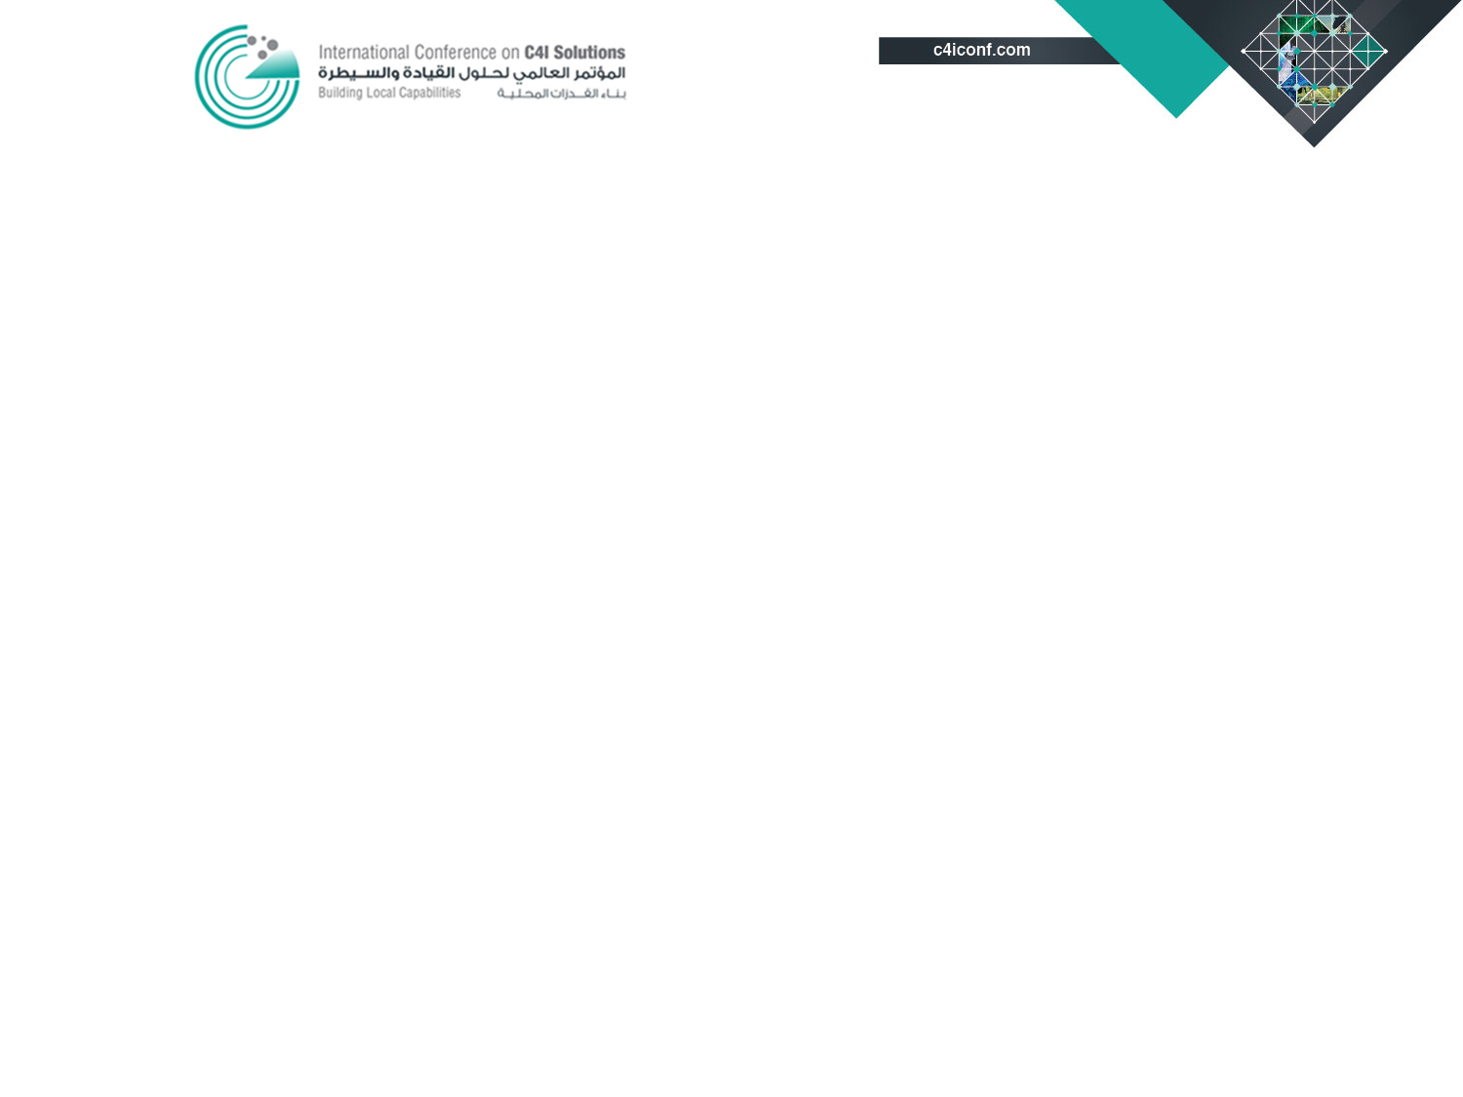
Futuristic view of C4I systems in civil and defense -- Requirements and road map

Slide 3
Sequence
Command, Control, Communications, Computer & Intelligence (C4I)
Tenets of C4I
Network-Centric Warfare
Communication and its Medium
Comparison of Transmission Bands
Role of Satellite Systems for Supporting
C4I Infrastructure
Advantages & Disadvantages of Ka-band
Regenerative Satellites
Conclusion

Slide 4
Command, Control, Communications, Computer & Intelligence (C4I) in Military Applications
What Is C4I?
The acronym C4I stands for "command, control, communications, computers, and intelligence“.
The Strategic Vision for C4I is to provide capabilities that enable forces to generate, use, and share the information necessary to survive and succeed
on every mission.
One important capability that C4I systems provide commanders is situational awareness—information about the location and status of enemy and friendly forces.

Slide 5
Command, Control, Communications, Computer & Intelligence (C4I)
Command and Control (C2) -The exercise of authority and direction by a properly designated commander over assigned and attached forces in the accomplishment of the mission
Communications - Communications network is the key enabler of C4I that transports information between all tiers of the battlefield
Computers - Support C2 and intelligence by processing information for achieving desired objectives
Intelligence (I) - Information and knowledge about an adversary obtained through observation, investigation, analysis, or understanding.

Slide 6
Command, Control, Communications, Computer & Intelligence (C4I)
AEW
Ground Radar
EW System
UAV
Command & Control
Battle Field Management System
Air Defense Surveillance Sys
Sensors
Computers
Communication
Intelligence
Integration,
Processing,
Correlation of Info
Radio Links
O/F Networks
SATCOM
Weapons
Fighter Aircraft
Missiles
Ground Troops

Slide 7
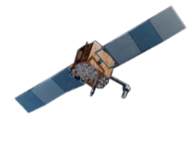


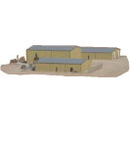
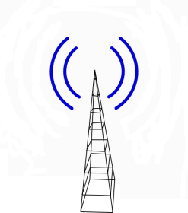



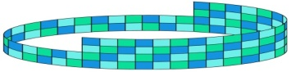







Command, Control, Communications, Computer & Intelligence (C4I) Architecture
VHF
UHF
UHF
AOC
SOC
Link-16
BOC
LRR
GES
C4I Secure Network
RECON
HF
GSS
PABX
ADOC
Link 11
GES
External Services
Missiles
Remote Workstation

Slide 8
Command, Control, Communications, Computer & Intelligence (C4I)
Command & Control | Communications | Computers | Intelligence
Processed information to support decision making | Transportation of information amongst all levels | Processing information for achieving desired objectives | Information gathering through observation, analysis
Decision Support Systems Battle Field Management System Air Defense Surveillance System | Voice and Data Networks Radio Links O/F Networks Satellite Communications | Integration, Processing, Correlation of gathered information | Sensors AEW Ground Radar EW System UAV

Slide 9
Tenets of C4I
The tenets of C4I are:_
A robustly networked force improves information sharing.
Information sharing and collaboration enhance the quality of information and shared situational awareness.
Shared situational awareness enables self-synchronization.
These, in turn, dramatically increase mission effectiveness.
The above capabilities are accomplished by a Reliable and Secure Communications Network.

Slide 10
Network Centric Warfare as a New Trend in C4I Applications
An emerging theory of war in the Information Age
Using information sharing to gain competitive edge
Increased shared situational awareness relying on computation and networked communications technology
Enhanced speed of command
Networking sensors, decision makers, and shooters
  to increases synergy for command and control, resulting in superior decision-making for an overwhelming war-fighting advantage.
10

Slide 11
C4I
Sensor
Shooter
Decision
Maker
Operator
Operator
Comm
Comm
System
(Radar)
System
(Combined Operational Picture)
System
(Aircraft)
NCW

Slide 12
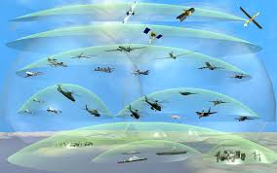
Advantages of NCW
Some military advantages that are expected from applying NCW systems to military operations include the following:
To achieve shared awareness,
Increased speed of command,
High tempo of operations,
Greater lethality,
Increased survivability, and
A high degree of self-synchronization.
The key principle of network centric operations is that: providing a superior level of integration among separate systems by allowing every user gets all the needed information in the correct format and in timely manner to achieve Interoperability and superior decision-making.
12

Slide 13













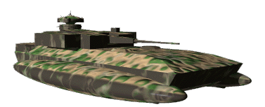





Network Centric Warfare – As a Dynamic Autonomous Digital Battlefield
Joint Air Support
UAV
JSTAR
RAH
LAM/PAM
Theater TOC
Airborne TOC
Field TOC
UAV
UAV
UAV
NLOS
NLOS
RECON
LOS/BLOS
MUGS
CDR/C2
NLOS/BLOS
Robotic
Sensor
NLOS
Infantry
Fighting
Vehicle
Robotic
Sensor

Slide 14
Role and Importance of Communications in C4I
C4I is about networking and cannot survive without effective communication means.
Communication provides essential linkages to war system at every level of operation.
The importance of communication in C4I makes it our primary center of gravity for opponents to exploit our warfare capability
Communication - is the heart beat of
C4I systems

Slide 15
Challenges concerning the deployment of C4I Systems
Communication challenges:
  Interoperability: no seamless and dynamic interoperation between C4I nodes.
  Protocols Mismatched: no exchange of relevant information due to lack of consistent format.
  Different Software: versions and releases between C4I nodes are not the same
  Different Operating Systems
  Obsolescence in Technology: hardware and software
  Integration of New technology with legacy systems
  QOS Requirements
  Bandwidth limitation due to type of Medium and Service locations
15

Slide 16
Comparison between Communication Media
 | Wireline | OFC | MW | Satellite
Bandwidth | Low | Max | Limited | Moderate in Ka Low in C&Ku
Deployment | Difficult (subject to terrain & distance) | Difficult (subject to terrain) | Easier (subject to distance) | Easiest (independent)
Geographical Range | Limited | Limited | Limited (LOS) | Unlimited (BLOS)
Mobility | Poor | Poor | Moderate | High
Propagation Delay | Low | Low | Low | High
Flexibility | Poor | Poor | Moderate | High
Susceptibility to ECM | Moderate | Very Low | High | High

Slide 17
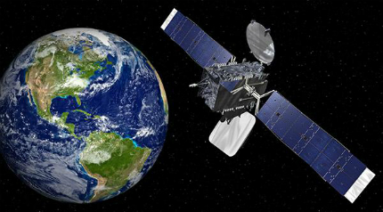
Advantages of Satellite System to C4I
Provides high mobility and quick deployment (Tactical operations)
Wide geographical coverage (Remote Locations)
Installation and running costs are independent of distance (Budgetary)
Independent of terrestrial infrastructure (Flexibility)
Maintenance free medium (Reliability)

Slide 18

Disadvantages of Satellite Systems
Limited BW compared to fiber networks (Transponders and Power Limitation)
Propagation delay (Effect on Encryption and Synchronization)
Susceptibility to ECM and Threat Access
(Interception, Jamming, Spoofing or Cyber Attack)
Dependence on weather (Rain (Fading)

Slide 19
Satellite Transmission Bands
Frequency Band | Downlink | Uplink
C | 3.7 – 4.2 GHz | 5.925 - 6.425 GHz
Ku | 11.7-12.2 GHz | 14.0-14.5 GHz
Ka | 17.7-21.2 GHz | 27.5-31.0 GHz
X-band is not considered due to complexity of equipment for this purpose.

Slide 20
Comparison between Satellite Bands
Frequency Band | Throughput/ VSAT | Antenna Size | Coverage | Propagation Delay | Rain Fade
C | 0.1–0.5 Mbps | Large | Global | 0.5 sec | Low
Ku | 2-6 Mbps | Small | Wide Beam | 0.5 sec | High
Ka | 8-20 Mbps | Smaller | Spot Beam | 1.0 sec (due to Double Hop) | Higher
Advantages
Disadvantages
Ka-band is the current trend in Satellite Communications due to other bands are becoming saturated

Slide 21


Wide Beam Propagation : C & Ku Bands
SATCOM
Information travels to a site in a
Single Hop

Slide 22
Ka-band: Multiple Spot Beams
SATCOM
Beam 3
Beam 1
Beam 4
Beam 2

Slide 23
Ka-band: Spot Beams Satellites
Typical Satellite acts as a repeater station in the space.
Spot beam satellites provide fixed data channel to communicate between different beams.
It can be said that communication channels between beams are hard wired. This is called the Bent Pipe Architecture
Therefore all the data received from various users by the satellite is transmitted to the Satellite HUB station and then re-transmitted to the desired destination by the satellite (double Hop architecture)
Steerable beams allows more flexibility with respect to Coverage areas.

Slide 24
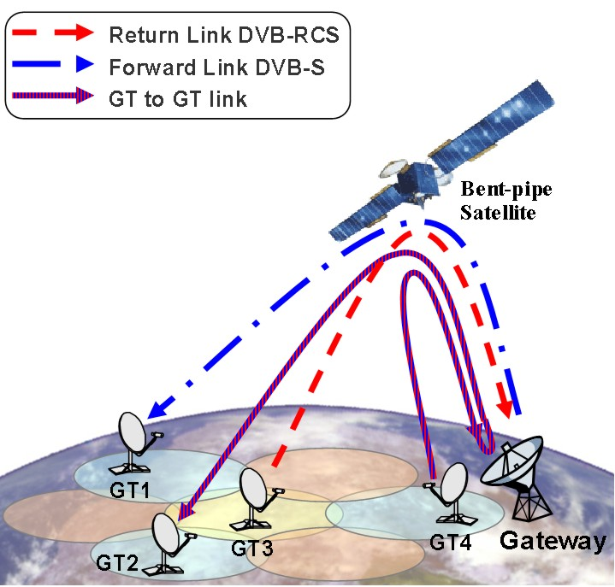
Bent Pipe Satellites

Slide 25
Spot Beam Propagation : Ka-band
SATCOM
Transmission A B
Information travels from site to site in a
Double Hop
Site A
Hub Station
Site B

Slide 26
Advantages of Ka-band over other Bands
Greater throughput
More potential: currently widely used as lower bands such as C/ Ku become more congested
Spot Beam –
  Enables Frequency re-use as explained in upcoming slide
  Less susceptible to interception and jamming
High Mobility - smaller dish size
Some Disadvantages of Ka-band
Propagation Delay – Double hop due to Bent pipe architecture
Rain Fading - Due to absorption of high frequency electromagnetic waves by water droplets

Slide 27
Ka-band: Frequency Re-use on Spot Beams
Frequency is re-used in non-adjoining spot beams to avoid interference
Frequency re-use is achieved by alternating the frequency sub-band and/or polarization used by each spot beam across coverage area
Frequency re-use increases the overall satellite capacity
Greatest commercial advantage

Slide 28
Overcoming Propagation Delay in Current Bent Pipe Architectures
SATCOM
From Remote Site to AOC in
C4I Platforms
2
1
Site B
Gateway Station
Site A
3
AOC
(C2 Center)
Remote Site
Fiber Optical Cable

Slide 29
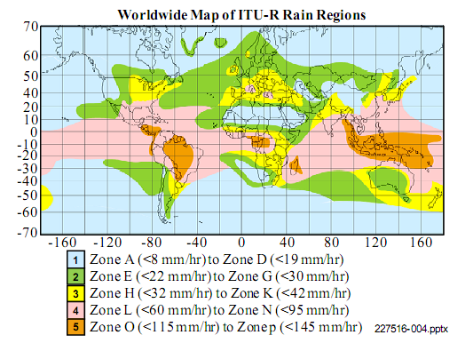

Slide 30
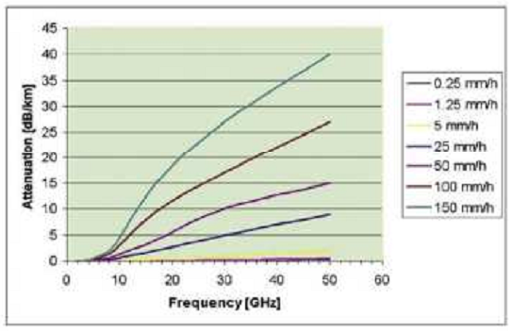
Attenuation caused by Rain Fade
Ka-band is great for MENA region as it receives less Rainfall leading to lesser attenuation

Slide 31

Threats to Information Security
Major Threats
  Jamming
  Interception
  Spoofing
Counter Measures
  Transmission Security (Transec)
  Communication Security (Comsec)

Slide 32
Overcoming threats to Information Security
OSI Model
COMSEC
Content protection
Radio interface
Authentication / confidentiality
Network Layer
Data Link Layer
Physical Layer
Physical Security
NETSEC
Protection of signaling
Transmitter authentication
Data Link Layer
Physical Layer
TRANSEC
Protection of waveform
Transmitter finding
Receiver jamming
Physical Layer

Slide 33
Overcoming threats to Information Security
TRANSEC
Protection of waveform from interception and direction to avoid receiver jamming, transmitter finding and access to radio signal.
Spread spectrum
Implemented at Physical Layer

Slide 34
Overcoming threats to Information Security
COMSEC
Protection of information content by safeguarding authentication, confidentiality, integrity of signal and user data
Implemented at Physical, Data Link and Network layers
May be achieved through secure VPN or Cyber Protection Systems

Slide 35
Regenerative Satellite System
Space Segment
Rx
Demod
Packet Switch
Mod
Tx
Uplink
Downlink
Site A
Ground Segments
Site B

Slide 36
Regenerative Satellite
Uplink carrier is
      Demodulated to data packets,
      Rearranged on the basis of routing information
      Re-modulated onto downlink carrier
      Re-transmitted to the desired spot beam.
  Data from a particular beam can be transmitted to any beam by using satellite onboard switching
Improved (S/N) as data is regenerated which removes noise leading to higher throughput
Enabling on board satellite switching avoids Double Hop propagation delay for site to site communications
Very expensive satellite
Regenerative satellite is the latest trend in SATCOM technology with onboard switching and routing, enabling communications directly between terminals in a single hop without requiring a central hub.

Slide 37
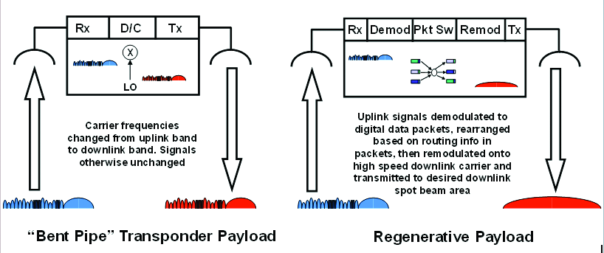
Bent Pipe versus Regenerative Satellites

Slide 38
Conclusion
Communication is the fundamental component of C4I which is the key enabler of NCW
Optical fiber provides maximum bandwidth connectivity in (Tbps) but has lesser flexibility for remote deployment
Satellite is the best suited to provide interconnectivity, survivability and interoperability for remote and mobile setups due to easy deployment however it has limited bandwidth capacity and greater propagation delay.
Ka-band satellites provide greater throughput than C or Ku band Satellites
Most Ka-band satellites are base on Bent Pipe architecture whereby a double hop is needed to communicate between remote sites

Slide 39
Conclusion cont’
The double hop in Ka-band (bent pipe) satellites may be avoided by providing fiber connectivity from Satellite Gateway to fixed sites (specially AOC) where possible.
Regenerative on Board Processing Ka satellites provides routing and switching on the satellite which enhances throughputs and avoids double hop propagation.
Regenerative Ka-band communication satellites are the new trend on SATCOM technology and will be the best suited for military use in C4I applications.
SATCOM is an essential requirements for C4I by:-
    Deployed tactical forces,
    Providing ideal continuity for operational services.
Standard Gigabit Ethernet (GE) interface as an open system architecture approach allows easy interconnectivity and interoperability to connect all C4I nodes.

Slide 40
Any Questions?
Thank you

