Slide 1


C4I, Internet of Things and
Critical Infrastructure Protection
Blake Davis
Director of Engineering for C4ISR,
Lockheed Martin

Slide 2
What Systems?
Military Command and Control
  Military Command and personnel
  Sensors (Radars, optical, vibration, heat, RF, etc)
  Defensive systems (kinetic and non-kinetic)
  Offensive Weapon systems (kinetic and non-kinetic)
  Security trained system builders
Military Infrastructure
Public Infrastructure
Commercial Infrastructure
Lockheed Martin Proprietary Information
Notes:
All public source
Image already received PIRA approval from prior C2BMC brief

Slide 3





Critical Infrastructure
Energy and Distribution
Transportation
Health
Civil protection and emergency response
Government
Communications (Fiber and Radio Frequency and Laser)
Water (and Wastewater) and Food Supply
Information Technology (including Industrial Control Systems)
Financial System
Critical Manufacturing
Lockheed Martin Proprietary Information
Notes:
All public source

Slide 4




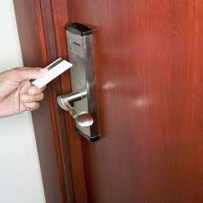

How? Threat Examples
Real life attack vectors
  2014 Target Store attack through HVAC system to Payment systems credit/debit cards
  2017 Austrian Hotel ransom
  through Door Lock system
  2015 Ukraine electric grid (PCC) leaving 230,000 without power thru industrial control systems
  2016 Ukraine Artillery Units through Android
Notes:
All public source
Target: https://www.computerworld.com/article/2487452/cybercrime-hacking/target-attack-shows-danger-of-remotely-accessible-hvac-systems.html
Ukraine power: https://www.reuters.com/article/us-ukraine-cybersecurity-usa/u-s-helping-ukraine-investigate-power-grid-hack-idUSKCN0UQ24020160112 & https://www.wired.com/story/russian-hackers-attack-ukraine/
Ukraine Artillary: https://www.reuters.com/article/us-cyber-ukraine/russian-hackers-tracked-ukrainian-artillery-units-using-android-implant-report-idUSKBN14B0CU
Austrian Hotel: https://www.nytimes.com/2017/01/30/world/europe/hotel-austria-bitcoin-ransom.html

Slide 5

Why?
Insider Threat more prevalent
Older industrial control systems with no design reqts for cyber
  end up added to and contribute to vulnerable networks
  No anti-virus, no security, no protection S/W
Component controls are targets as well as back up control systems
Protection is needed at multiple entry points
Air gapping system still not sufficient (High latency network)
  Remote admins, vendor supply chain, 3rd party maintainers
Protection and Risk Postures
  Can’t assume device is secure
  Can’t assume network is secure
  Cost is major driver to securing or not securing
    Not just at customer side but at manufacturing side
Lockheed Martin Proprietary Information
Notes:
All public source
Image already received PIRA approval from prior C2BMC brief

Slide 6

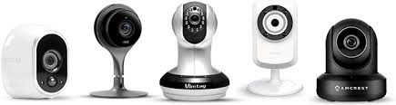
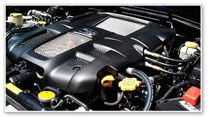
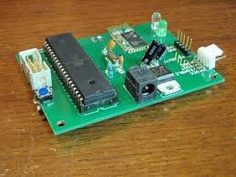
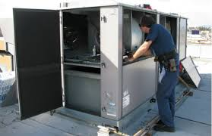
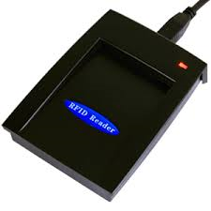
Internet of Things
Estimates are 20-30 billion IoT in next
few years
Cameras
Cars / Trucks
Door locks and facility related
management equipment
100+ billion microcontrollers
100+ billion RFID devices
Threat:
  New entry points
  Easy DDOS source
Trend:
  Some attention to strengthen security at “the thing”
  Secure comm, encryption
Notes:
All public source

Slide 7
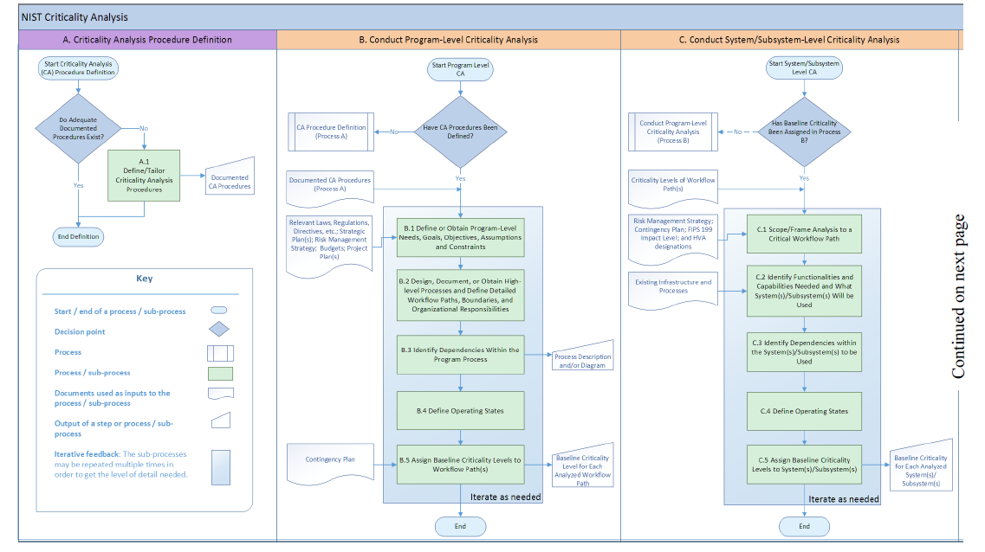
Key is Response ahead of attack
NIST Criticality Analysis
  Prioritize Protection
    https://csrc.nist.gov/csrc/media/publications/nistir/8179/draft/documents/nistir8179-draft.pdf
Move to Cyber resilient architecture
  survivability under attack – continuous feedback
  Radical shift in how control systems are designed
    https://www.mitre.org/capabilities/cybersecurity/resiliency
Reduce attack vectors, entry points
Understanding Normal – behavior based protection
  Increased monitoring and comparison to normal
Notes:
All public source

Slide 8
Cyber Security: Lockheed Martin
Cyber Kill Chain®
1
Reconnaissance
2
Weaponization
3
Delivery
Aggressor has to successfully pass through every step
Defenders can block just one step in the chain
4
Exploitation
5
Installation
6
Command & Control
7
Actions on Objectives
Notes:
PIRA approved confirmed with Kathleen Hohendal

Slide 9
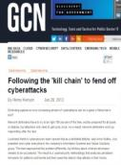
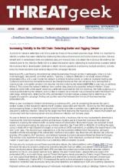
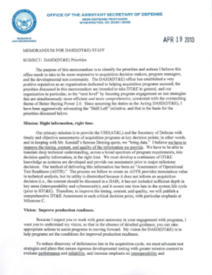
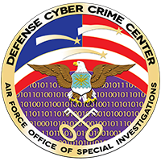


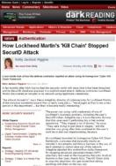
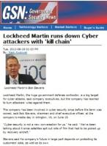
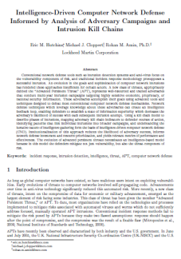

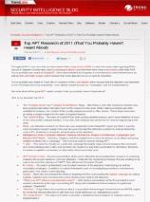

Solutions From Headlines to Best Practices
“This is a must-read for anyone tracking APT.” – Trend Micro
Information Sharing
Indicator Sharing with Defense Industrial Base done using Kill Chain phases
DHS To Apply CKC method for internal network Security
Senate Commerce Committee analyzes Target breach using LM methodology
DoD AT&L DT&E incorporates Cyber Kill Chain into cyber security testing supporting weapons systems acquisition
Kill Chain part of Structured Threat Information Exchange format since Version 0.3
“LM’s seminal paper on Intelligence-Driven Computer Network Defense published
LM’s Cyber Kill Chain garners attention from cyber security and technology industry experts
Notes:
PIRA approved confirmed with Kathleen Hohendal

