Slide 1
Challenges & Prospects
by Dr. Zaidan Alenezi, D.E.

Slide 2
Background
Systems of human, physical and information resources to accomplish missions
Military
Emergency Response
Disaster Management
Apply resources in any form to make decisions about a specific goal
Effective versus Efficient
2

Slide 3
Background
Human Resources represent all activities of operations, planning, coordination, execution, policies & procedures, quality, etc.
3

Slide 4
Background
Physical Resources represent the fixed assets such as facilities, equipment, etc.
4

Slide 5
Background
Information Resources represent data, information, intelligence and insights
The system to generate, store, process, communicate, etc. flow of information
The fluid of any C4I system
SITUATION AWARENESS
5

Slide 6
Challenges
Human Resources. The human capital supply in data science
Information Resources. Information needs to be:
Specific
Actionable
Timely versus Real Time
Measureable
6

Slide 7
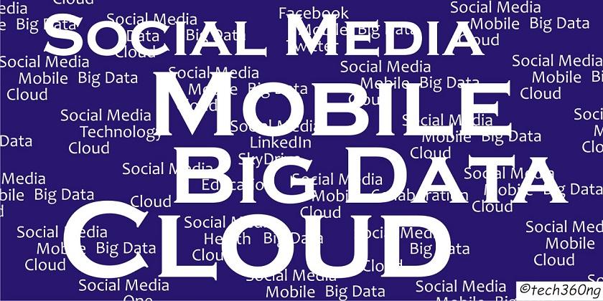
Information Growth
The supply of information is rising unprecedentedly
7

Slide 8
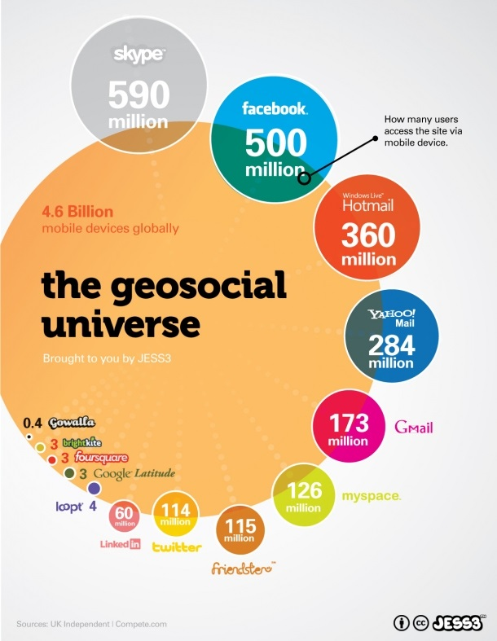
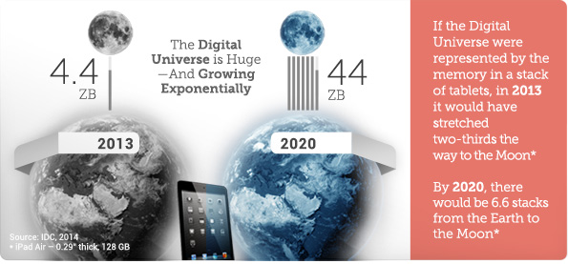
Information Growth
8

Slide 9
Information Growth
Annual global IP traffic will reach 2 zettabytes per year by 2019
Mega, Tera, Peta, Exa, Zetta, Yotta
“The data we create and copy annually – will reach 44 zettabytes, or 44 trillion gigabytes”
9

Slide 10
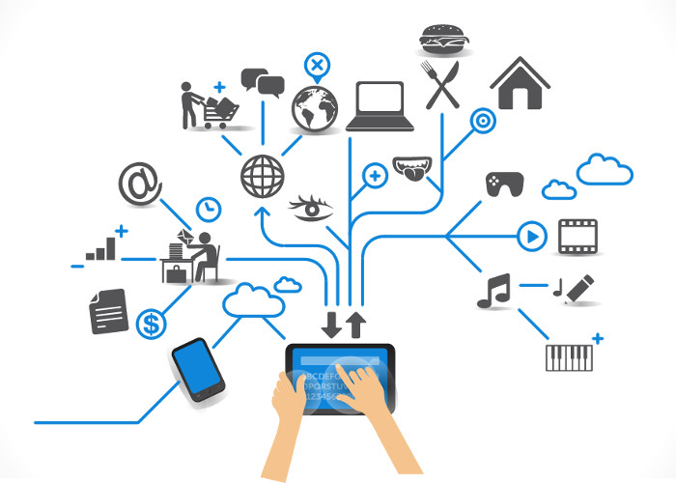
Information Growth
10

Slide 11
Concluding Highlights
Increase human capital effectiveness
Training: Knowledge + Skills
Big Data, Large Scale Database Management Systems
Promote Openness
Standards
Interopreability
11

Slide 12
Thank You

