Slide 1
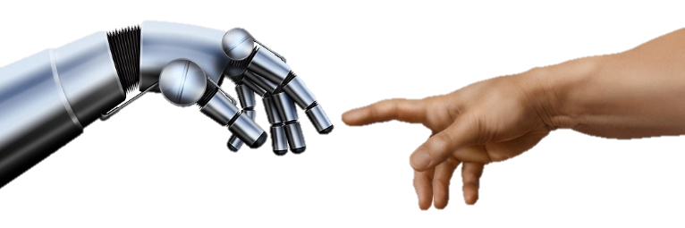
The Challenges of Complex Socio-Technical Systems and Counter Measures
التحديات التي تواجه النظم التكنو اجتماعية وطرق معالجتها
Notes:
Science and technology are big contributions to the economic development, but can also lead to negative side effects as it evolves. For example, people care more about materialistic things than the negative influences they have created in human morals and education.
Many social problems have appeared in society and cannot seem to be solved by natural science and technology alone. It requires the need for social sciences as well. Social technology is the strategy used to help solve the wrong behaviors in the world that are caused by social
The difference between the past and present technology is the extent of social binding. The more social forces it binds together the more powerful the technology is.

Slide 2
Complex-Socio-Technical Systems
Challenges of Complex Socio-Technical
Information Technology
Challenges
Notes:
Logical sequence of the subject

Slide 3
Complex Socio-Technical Systems
System
Complex System
Socio-Technical
systems

Slide 4

System
Complex Socio-Technical
Complex System
Socio-Technical
systems
Notes:
We here system in every where, educational system, financial
But what we mean here is
A purposeful collection of inter-related components working together to achieve some common objective.
May contain hardware ((mechanical, electronic) software and operated by peaple

Slide 5
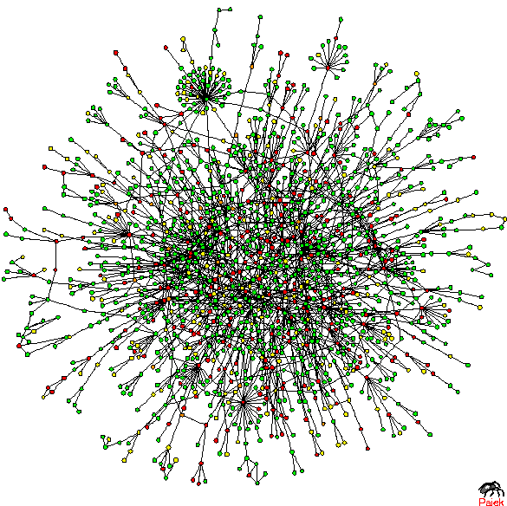
System
Complex Socio-Technical
Complex System
Socio-Technical
systems
Notes:
The term sociotechnical systems was coined by
Eric Trist, Ken Bamforth and Fred Emery, in the World War II era, based on their work with workers in English coal mines at the Tavistock Institute in London
The idea of a sociotechnical system (abbreviated as STS) is an intellectual tool to help us recognize patterns in the way technology is used and produced. Identification of these patterns will help us to analyze the ethical issues associated with the technology-and-its-social-system.

Slide 6
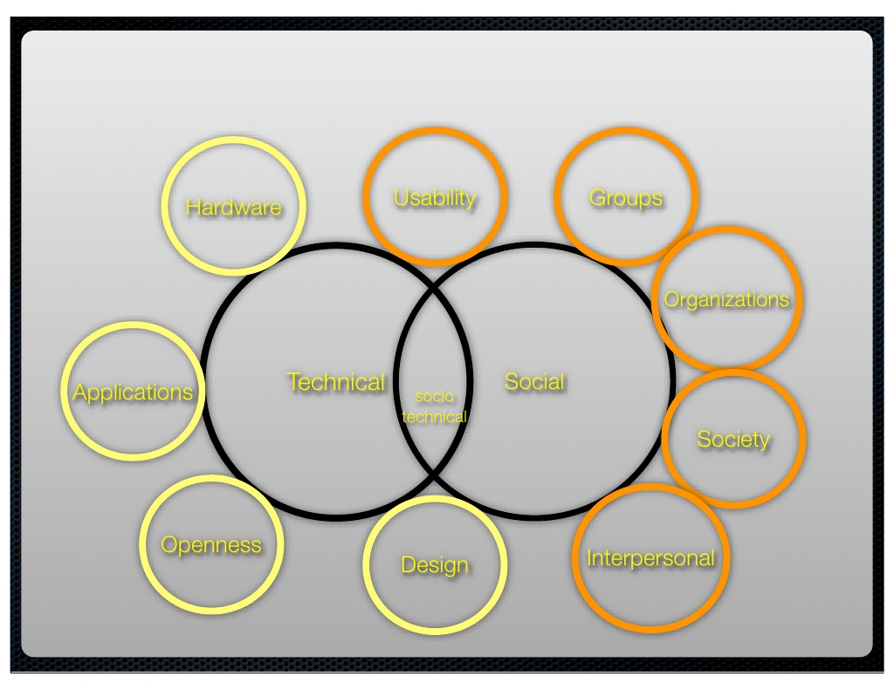
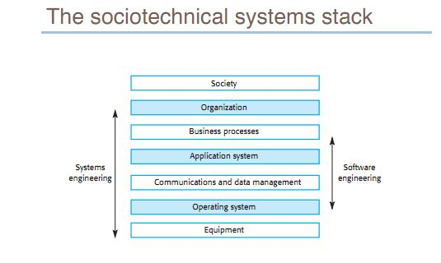
System
Complex Socio-Technical
Complex System
Socio-Technical
systems

Slide 7
Information Technology
Socio-technical system characteristics:
• Emergent properties.
• Non-deterministic.
• Complex relationships with organizational objectives.
Notes:
Properties of the system of a whole that depend on the system components and their relationships.
Volume
The volume of a system (the total space occupied) varies depend ing on how the component assemblies are arranged and connected.
Reliability
System reliability depends on component reliability but unexpected interactions can cause new types of failure and therefore affect the reliability of the system.
Security
The security of the system (its ability to resist attack) is a complex property that cannot be easily measured. Attacks may be devised that were not anticipated by the system designers and so may defeat built-in safeguards.
Repairability
This property reflects how easy it is to fix a problem with the system once it has been discovered. It depends on being able to diagnose the problem, access the components that are faulty and modify or replace these components.
Usability
This property reflects how easy it is to use the system. It depends on the technical system components, its operators and its operating environment.
They do not always produce the same output when presented with the same input because the systems’s behaviour ispartially dependent on human operators.
The extent to which the system supports organizational objectives does not just depend on the system itself.

Slide 8
Information Technology
Rapid technological change as we live in environment that are increasingly technology saturated
Notes:
The first computer was conceived of as a machine of cogs and gears. It became operational in the 1950s and -60s with the invention of semi-conductors.
In the1970s, a hardware company called IBM was a computing leader
In the 1980s software became more important, so by the 1990s a software company called Microsoft took the computing lead, giving ordinary people tools like word-processing.
During the 1990s, computing became more personal, as the World-Wide-Web turned Internet URLs into web site names that people could read . Then a company called Google offered the ultimate personal service, free access to the vast public library we call the Internet, and everyone's gateway to the web became the new computing leader.
The 2000s computing evolved yet again, to become a social medium as well as a personal tool.
The World
Wide Web was initially an information web (Web 1.0), then an active web (Web 2.0), now a semantic web (Web 3.0) and is becoming a social web (Web 4.0).

Slide 9
Information Technology
Processing Speed
Connectivity
Services

Slide 10
Information Technology

Slide 11
Challenges
Study by Lucas of over 2000 systems in 16 companies found:
“It is our contention that the major reason most info systems have failed is that we have ignored organizational behavior problems in the design and operation of computer-based information systems.”
Focusing on one of these systems to the exclusion of
the other is likely to lead to degraded system performance and utility.

Slide 12
Challenges
socio-technical design methods are rarely used.
STSD methods provide advice for system designers rather than detailed methodologies that should be followed.
We suspect that the reasons for their lack of use are, primarily, difficulties in using the methods and the disconnect between these methods and both technical engineering issues, and issues of individual interaction with technical systems.
Notes:
ETHICS considers the introduction
of a new system as part of a broader change process. There are four identifiable
aspects to this change process that need to be considered:
1. Setting and achieving system objectives that take into consideration the
differing views of all of the system stakeholders.
2. Adaptation to the new system and new ways of working.
3. Integration of the various elements of the new system into a coherent,
functioning whole.
4. Stabilisation of the new ways of working.
Socio-technical approaches can help the design of
organisational structures and business processes as well as technical systems.
The source of the problem is that techno-centric approaches to systems design do not properly consider the complex relationships between the organisation, the people enacting business processes and the system that supports these processes

Slide 13
Challenges
Cyber Security:
Technology is not reliable
Insider threat
Poorly designed organizational procedure
Human carelessness
Social Engineering

Slide 14
Challenges
Optimization and throughput
The way that employees interact with each other or react to such new tech or social media is increasingly unpredictable
Notes:
Process changes
• Does the system require changes to the work processes in the environment?
● Job changes
• Does the system de-skill the users in an environment or cause them to change the way they work?
● Organizational changes
• Does the system change the political power structure in an organisation?

Slide 15
Challenges
Some of Emergence properties is hard to measure due to social behavior.
Such as Safety, Security
  Sa
  s

Slide 16
Challenges
New organizational forms have become fashionable, e.g.:
- virtual organizations
- dynamic networks.

Slide 17
Challenges
Legacy Systems.
New Technologies may have to be implemented to increase and maintain an org's output (Big Data/Big Computing/SOAs)

Slide 18
Questions ????

